Slide 1
Un calendrier français
Lundi 6 juillet 2020

Slide 2
Un calendrier
Can you look at each festival and write down in French when it is ?
Example :
Noël c’est le 25 décembre
Christmas is on the 25th December
!!! Remember … no capital letters for the months of the year !!!

Slide 3
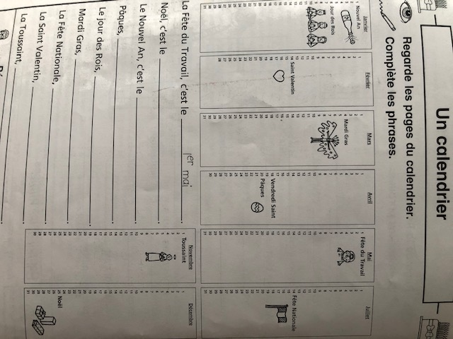

Slide 4
Answers
La Fête du travail c’est le 1er mai
Noël c’est le 25 décembre
Le Nouvel An c’est le 1er Janvier
Pâques c’est le 20 avril
Le Jour des Rois c’est le 6 Janvier
Mardi Gras c’est le 4 mars
La Fête Nationale c’est le 14 juillet
La Saint Valentin c’est le 14 février
La Toussaint c’est le 1er novembre

Slide 5
There are 11 public holidays in France
Le Jour de l’An (New Year’s Day)
Lundi de Pâques (Easter Monday)
La fête du travail (May Day)
Victoire 1945 (Victory in WW2)
Ascension
Lundi de Pentecôte (Whit Monday)
La Fête Nationale (Bastille Day)
Assomption (Assumption)
Toussaint (All Saint’s Day)
Armistice 1918 (Armistice Day)
Noël (Christmas)

Slide 6
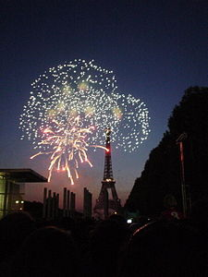
Le jour de l’An (New Year’s Day)
As in England and in most part of the world, this festival is dedicated to the coming year. After having celebrating New Year’s Eve, the first of January is a day off.
In France, the most popular place to spend New Year’s Eve is the Effel Tower in Paris. Each year, thousand and thousand of people gather around it to celebrate this day. To this extent, the Effel Tower usually uses giant fireworks and change colours for a moment.

Slide 7
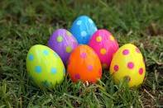
Lundi de Pâques (Easter Monday)
Easter Monday is the day after Easter Sunday and is celebrated as a holiday in some largely Christian cultures. Religiously, this festival celebrates the resurrection of Jesus-Christ.
What is specific on this day is that, when you are young, children usually receive chocolate. Parents also usually hide the chocolate eggs in the garden or in the house, and in the morning the children have to find all of them.

Slide 8
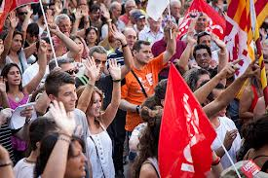
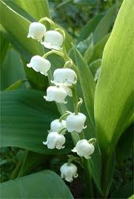
La fête du travail (May Day)
Date : May 1st
May Day mainly celebrate the achievements of workers.
In France, it became a custom for workers to demonstrate on that very day. Each year, millions of people gather in the street. It is usually a protest march leading by activists in order to show their dissatisfaction.
This is also the day when people give flowers to each other.

Slide 9
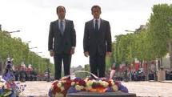
Victoire 1945 (Victory in Europe Day)
Date : May 8th
« Victoire 1945 » marks the date when the World War II Allies formally accepted the unconditional surrender of the armed forces of Nazi Germany and the end of Adolf Hitler's Third Reich, thus ending the war in Europe.

Slide 10
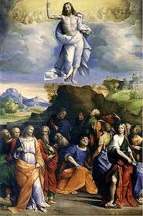
L’Ascension (Ascension Day)
Ascension Day commemorates the bodily ascension of Jesus into heaven. It is a moveable date, because it depends on the date of Easter. It has to take place on a Thursday, 39 days after Easter.

Slide 11
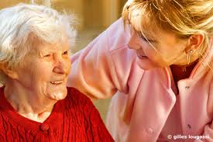
Lundi de Pentecôte (Whit Monday)
As for the Ascension Day, the « Lundi de Pentecôte » is a moveable date because it is determined by the date of Easter. It takes place 50 days after Easter.
In France, it is also the « Jour de solidarité » (Day of solidarity) created to support the elderly and persons with disabilities.

Slide 12
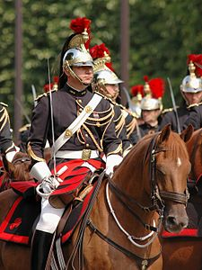
La fête Nationale (Bastille Day)
Date : July 14th
It is the National Day in France which is celebrated on the 14th of July each year.
The main event takes place on the Champs-Elysées avenue. The traffic is stopped and instead is a military parade.

Slide 13
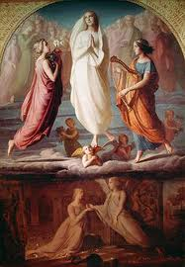
Assomption (Assumption of Mary to Heaven)
Date : August 15th
This festival celebrates the bodily taking up of the Virgin Mary into Heaven at the end of her earthly life.

Slide 14
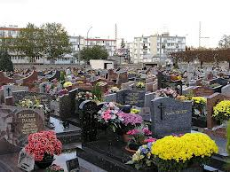
La Toussaint ( All Saints’ Day)
Date : November 1st
The religious meaning is an honour of all the saints, known and unknown.
In France, people usually take flowers to the graves of dead relatives, or light candles.

Slide 15
Armistice 1918 (Armistice Day)
Date : November 11th
It commemorates the armistice signed between the Allies of World War I and Germany at Compiègne, France, for the cessation of hostilities on the Western Front of World War I, which took effect at eleven o'clock in the morning.
In France, there are people and sometimes pupils in school who observe two consecutive minutes of silence at 11:00 a.m as a sign of respect : the first minute is for the roughly 20 million people who died in the war, and the second minute is dedicated to the living left behind, generally understood to be wives, children and families left behind but deeply affected by the conflict.

Slide 16
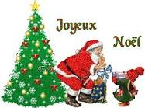
Noël (Christmas)
It is the last public holiday of the year in France. As in many countries, the tradition is to eat turkey during Christmas Eve.
What differ from one family to the other is when parents give the presents to the children. Some families give them on Christmas Eve, but others give them in the morning of the 25th of December.

Slide 17
There are 4 main others festival recognized by the society but without a day-off
Mardi-Gras (Shrove/Pancake Tuesday)
La fête des Pères / La fête des Mères (Father’s/Mother’s day)
La Saint-Valentin (Valentine’s Day)
La fête de la Musique (World Music Day)

Slide 18
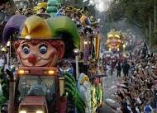
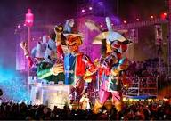
Mardi-Gras (Shrove/Pancake Day)
It’s a moveable date. As in many countries, children dress-up as they want : clowns, pirates, super-heros, princess..
It also leads to parades in the streets with a lot of floats and circus. The biggest carnival in France is the one from Nice, in the south-west of France.
It is also an occasion to cook pancakes or « crêpes » as we call it in French.

Slide 19
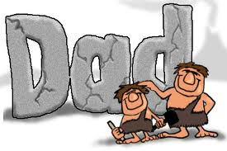
La fête des mères/des pères (Mother/Father’s day)
In France, this festival takes place on a moveable date, but generally in June. It is separated into two different dates, one for the mother, one for the father.
The tradition is for the children to draw a picture or make something up at school through their own imagination and then giving it to their father/mother : it can be a poem, a necklace..

Slide 20
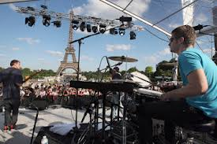
La fête de la musique (World Music Day)
Conceptualized in France in 1976, first took place in 1982 in Paris.
It become a worldwide phenomenon with over 32 countries celebrating it.
It is an opportunity to see famous bands for free, and to discover amateur bands as well.

