Slide 1
Lundi 13 juillet
Culture corner
Schools in France

Slide 2
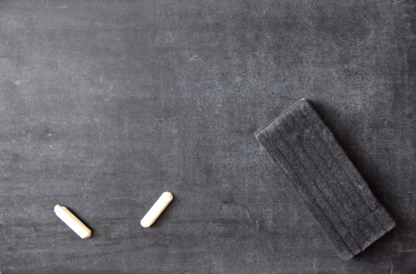
Le système scolaire en France
The school system in France

Slide 3
L’école primaire

Slide 4

L’école Maternelle
From three to six years old
La grande section
La moyenne section
La petite section

Slide 5

L’ école élémentaire
From 6 to 11 years old
Le CP
Le CE1
Le CE2
Le CM1
Le CM2

Slide 6
Le secondaire

Slide 7
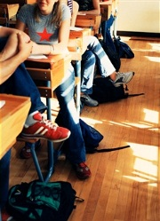
Le collège
From 11 to 15 years old
La sixième
La cinquième
La quatrième
La troisième

Slide 8
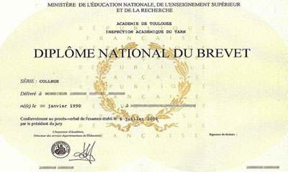
Le brevet
At the end of La troisième, you will have to pass Le Brevet, to enter le Lycée.
Le brevet is an examination on what you have learnt through le collège in French, maths, history and geography

Slide 9
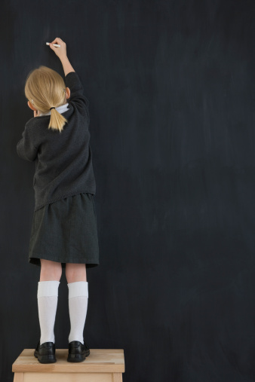
School is obligatoire until you turn 16
At this point, you can choose to
Go to Lycée
Start a CAP
Or leave school

Slide 10

Le lycée
From 15 to 18 years old
La seconde
La première
La terminale

Slide 11

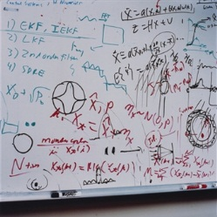
Les sections
The specialty you choose at the beginning of la première
Littéraire
Economique
Scientifique

Slide 12
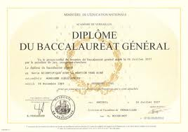
Le Baccalauréat – le bac
At the end of la Terminale, you will sit for your Bac.
It has 9 to 10 compulsory subjects.. Some are written exams, some are speaking exams.
The bac is necessary to enrol for university.

Slide 13
Les matières

Slide 14

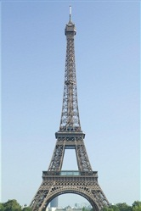
Le français

Slide 15


L’anglais

Slide 16
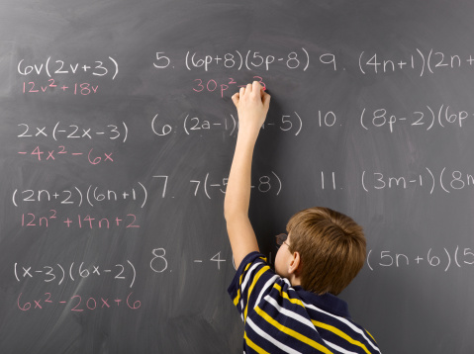
Les maths

Slide 17

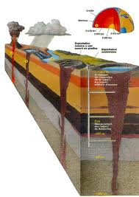
Le SVT (Sciences de la Vie et de la Terre)

Slide 18
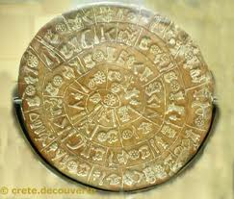
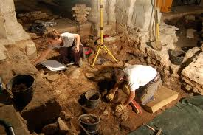
L’histoire

Slide 19

La géographie

Slide 20

La physique

Slide 21

La chimie

Slide 22
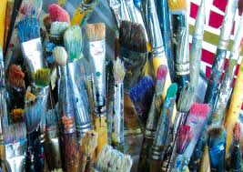
Les arts plastiques

Slide 23
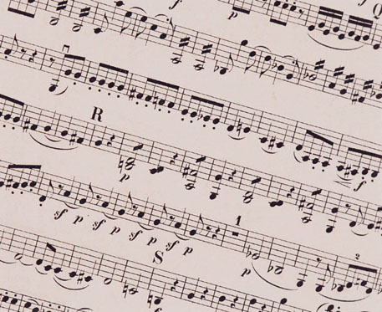
La musique

Slide 24
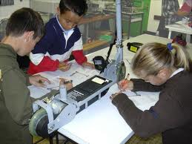
La technologie

Slide 25
Les options
In quatrième, you have to choose a second language (allemand, espagnol, italien)
In seconde, you have to choose between: a new language, latin, ancient greek, economy,…

Slide 26

Les devoirs
Every day, french students take their ‘devoirs’ home
It can be either exercises to complete or lessons to learn by heart

Slide 27
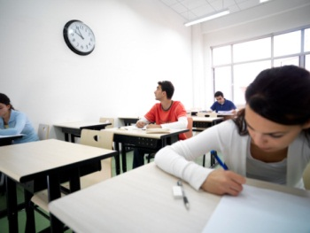
Les interros
Often, the profs walk in class to do an ‘interro surprise’ to check that the students have learnt their lessons properly.
The grade you get in these tests counts in your final grade.

Slide 28

Les punitions
If you didn’t do your homework or if your behaviour is not good, you will get a ‘colle’.
You will stay to school on Wednesday afternoon.
The colle can last between 1 and 5 hours.
The students are sent in the ‘salle de colle’ under the surveillance of the ‘pion’
They are not allowed to talk and have to produce work

Slide 29

Emploi du temps
French kids go to school from 8 in the morning to 4pm
They have one and a half hour lunch break
They usually don’t have classes on Wednesday afternoons
School goes from September to June
July and August are summer holidays.

Slide 30
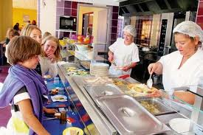
La cantine
French students can either stay at ‘la cantine’ for lunch or go back home.
Most French schools have ‘un self’’
French students pay a small price to eat a full meal

Slide 31
Les notes
Every mark you get is part of your ‘trimestre’ grade.
At the end of each ‘trimestre’, the teachers add up the marks and give an average grade in each topic.
These grades will give your ‘moyenne trimestrielle’
At the end of the year, we add up the three ‘moyennes trimestrielles’ to give your final mark.
If your grade is over 10 out of 20, you are allowed to move to the next year
If your grade is under 10, you will “redoubler”

Slide 32
Exemples
Louise et Jean are both in Seconde
In which class will they be next year?
Here are their grades for the year
let’s see how they went.

Slide 33
Louise
                Trimestre 1
Français: 11/20
Anglais: 12/20
Maths:8/20
Total:10.33/20

Slide 34
Trimestre 1: 10.33/20
Trimestre 2: 12/20
Trimestre 3: 9.5/20
Total: 10.61
Louise passe en première!

Slide 35
Jean
Trimestre 1
Français: 7/20
Anglais: 6/20
Maths: 11/20
Total: 8/20

Slide 36
Trimestre 1: 8/20
Trimestre 2: 9/20
Trimestre 3: 11/20
Total: 9.33/20
Jean doit redoubler.

Slide 37
Comparaisons
Can you think of any similarities with our schools in England ?
How different is the English system in your opinion?

