Slide 1
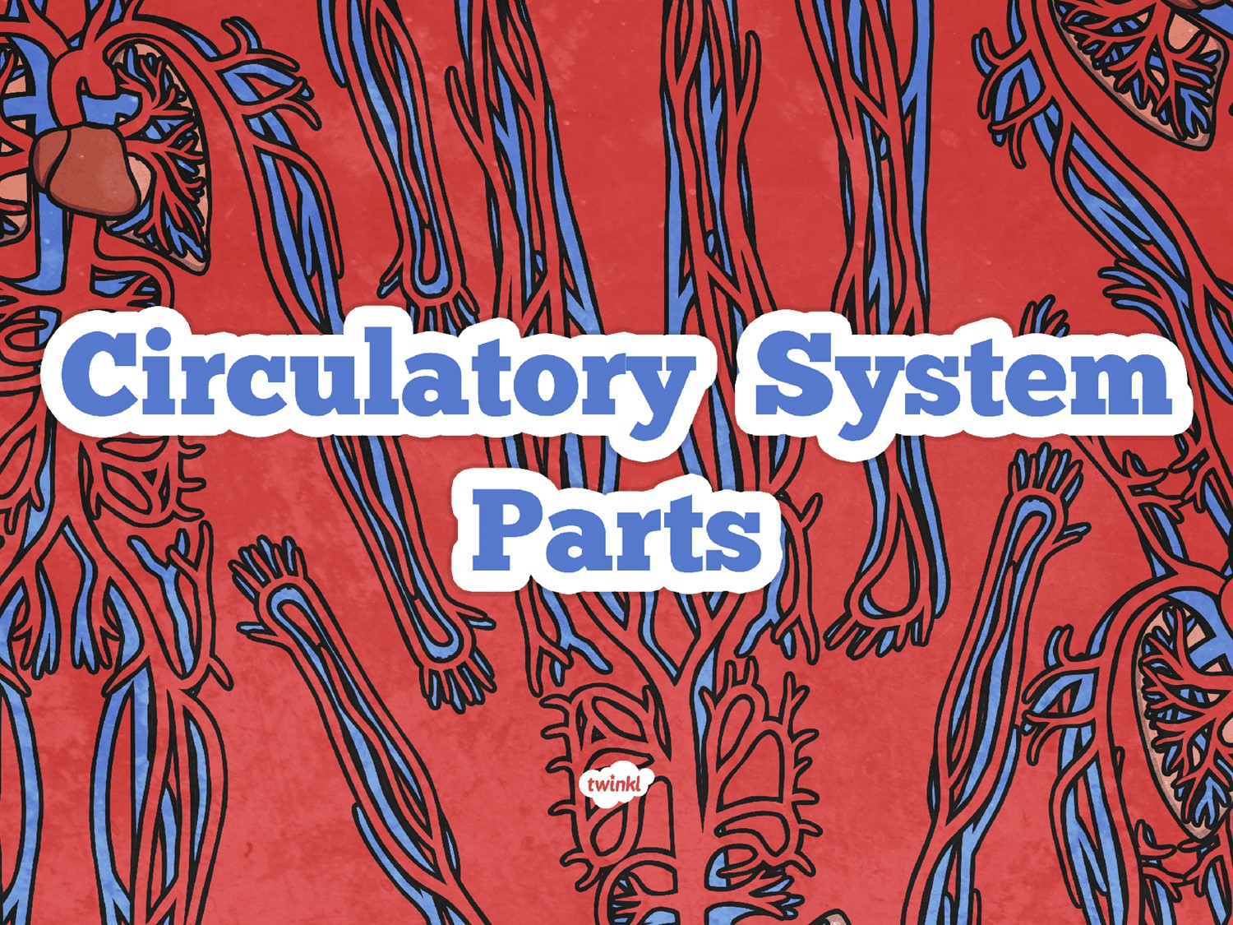
Lesson 2
Respiratory system and the muscular system

Slide 2
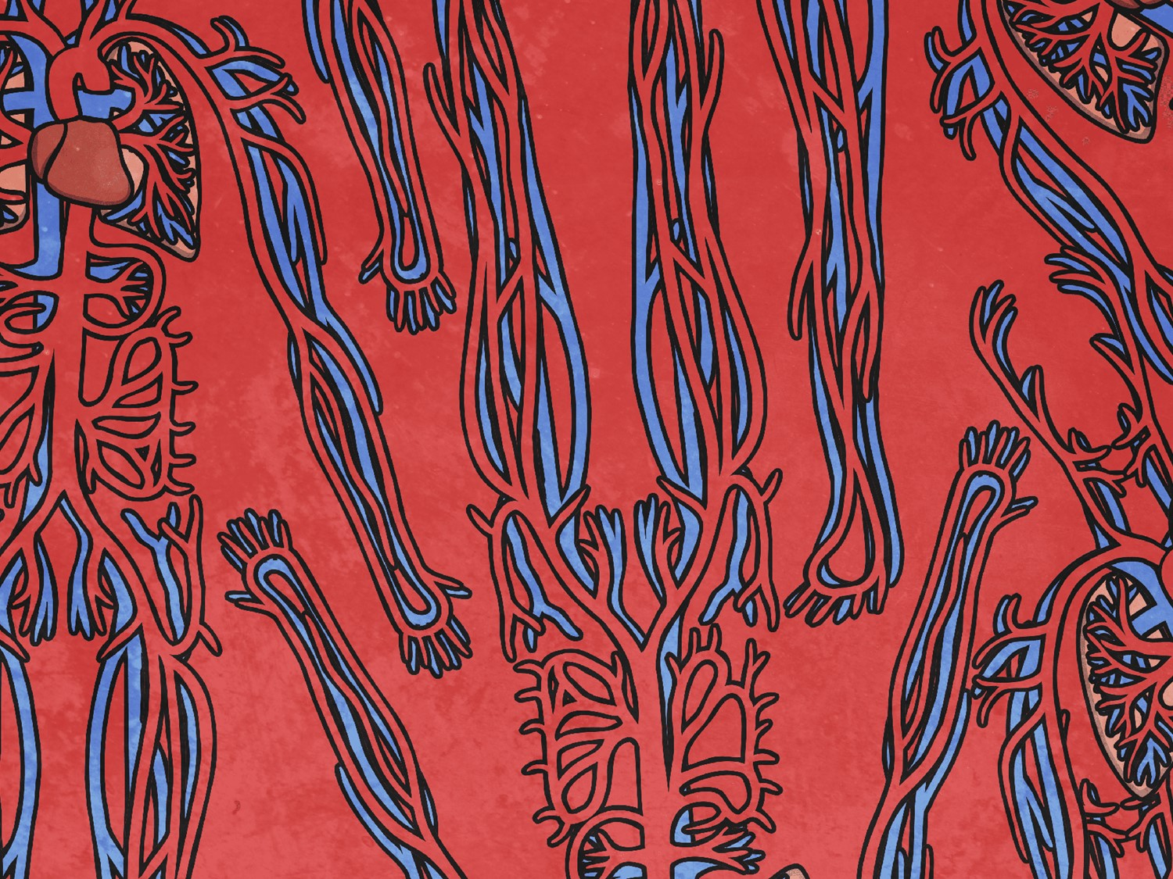
Aim
To explore how the respiratory system is linked to the circulatory system.
To explore how our lungs work.
Success Criteria
I can identify the main parts of the respiratory system.
I can identify the roles different parts play in the respiratory system.
I can explain the link between the respiratory and circulatory system.

Slide 3

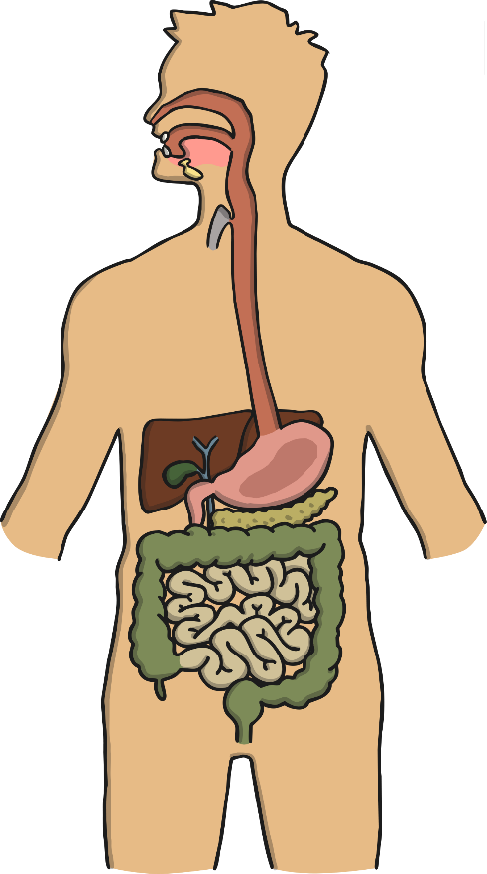
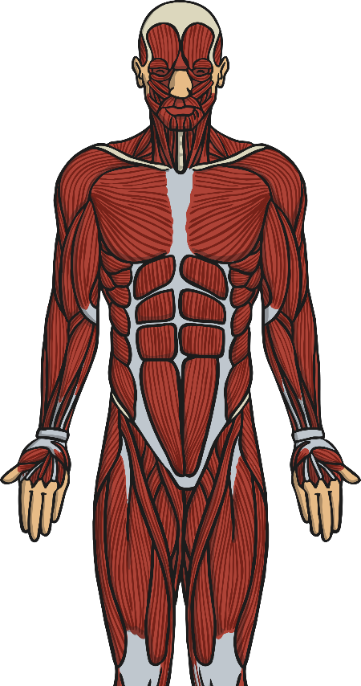
Quick Quiz
How many different systems in the human body can you name?
(clues for 2 are below!)

Slide 4
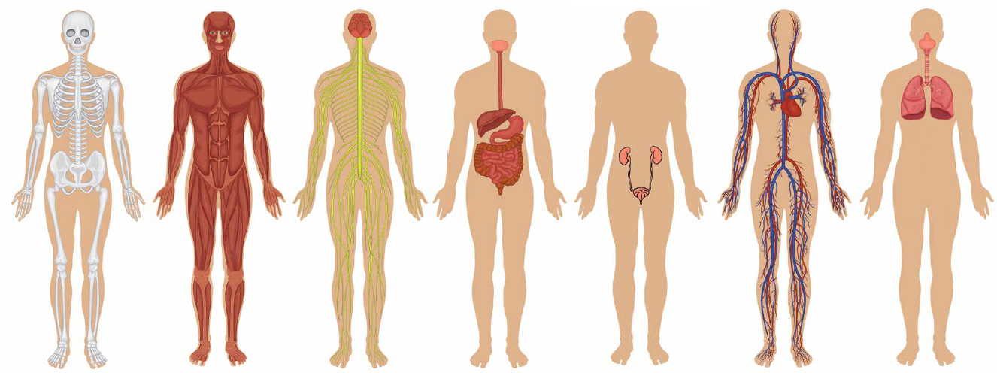
Quick Quiz
Did you remember all 7?
Skeletal system
Muscular system
Nervous system
Digestive system
Renal
system
Circulatory
system
Respiratory system

Slide 5

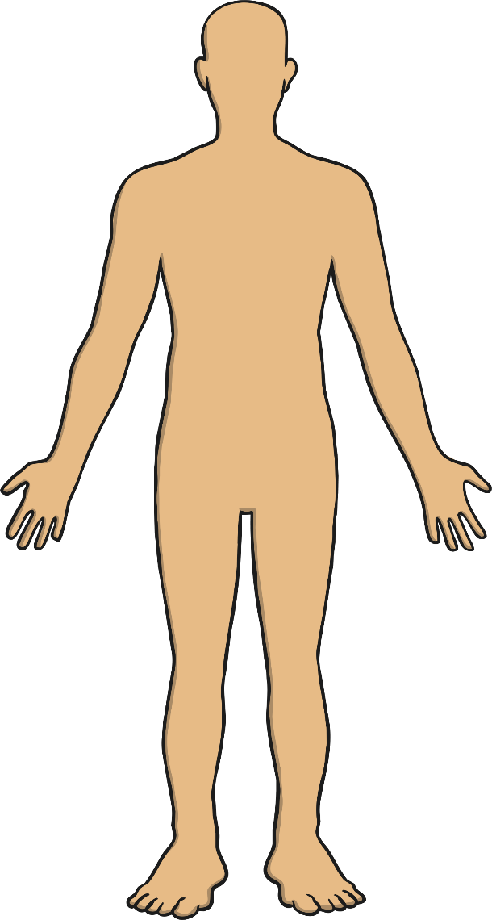

The Respiratory System
Today we are going to explore the respiratory system.
What do you think is the purpose of the respiratory system?
Have a think:
What do you think the system does?
Do you know the names of any parts of the system?

Slide 6
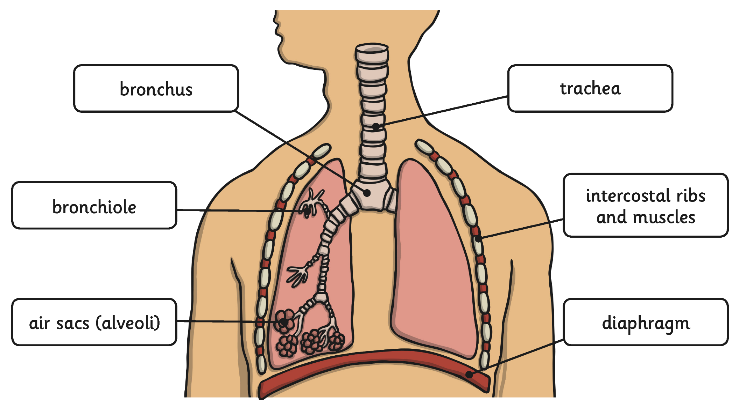

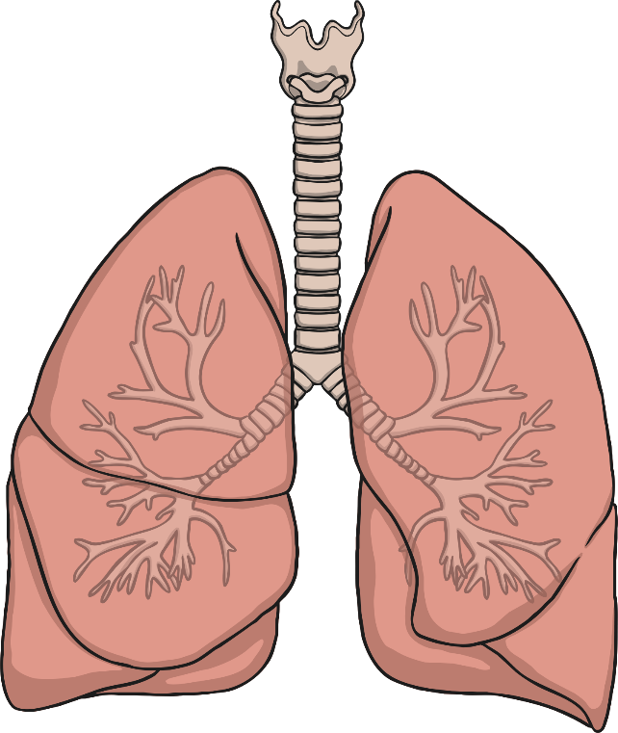
Parts of the Respiratory
System
We saw this yesterday but let’s take some more time to understand it.
Click me for a larger version!
Air breathed in through the mouth or nose travels down the trachea, through the bronchi into one of the lungs. The air travels into the bronchioles and into the air sacs (alveoli). From here, the gas is able to pass in to the bloodstream.
Click anywhere to hide.

Slide 7
Parts of the Circulatory
System
Complete page 4 in your booklet about the respiratory system and then continue.
You may also want to look at: https://www.ducksters.com/science/breathing.php

Slide 9

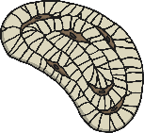
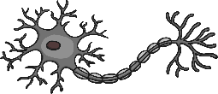
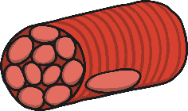
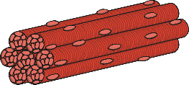
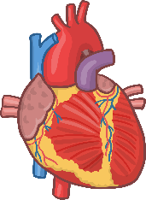
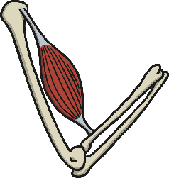
What are Muscles?
There are three types of muscle:
Our bodies are made up of different types of cells
smooth muscle cell
bone cell
nerve cell
Cells form to make tissue
Skeletal muscles are made up of just muscle tissue
Organs are made up of more than one type of tissue

Slide 10
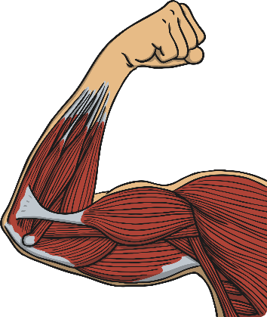

Voluntary and Involuntary
Some muscle movement is voluntary and we can control it. Other muscle movement is involuntary and we don’t have control over it.
Look at the pictures to the right: Which shows voluntary muscle movement and which shows involuntary?
Can you think of any other involuntary or involuntary movements?

Slide 11
Voluntary and Involuntary
Watch the following video and see what facts you can gather about the muscles of the human body.
https://www.youtube.com/watch?v=UGSi_HwgX0k
Use this information to help you complete the work on page 5 of your booklet.

Slide 12
What’s the difference between a muscle, ligament and tendon?
Match the name to the description:
muscle
ligament
tendon
A short band of tough, flexible fibrous connective tissue which connects two bones or cartilages or holds together a joint (such as the knee).
A band or bundle of fibrous tissue in a human or animal body that has the ability to contract, producing movement in or maintaining the position of parts of the body.
A flexible but inelastic cord of strong fibrous collagen tissue attaching a muscle to a bone.

Slide 13
What’s the difference between a muscle, ligament and tendon?
muscle
ligament
tendon
A short band of tough, flexible fibrous connective tissue which connects two bones or cartilages or holds together a joint (such as the knee).
A band or bundle of fibrous tissue in a human or animal body that has the ability to contract, producing movement in or maintaining the position of parts of the body.
A flexible but inelastic cord of strong fibrous collagen tissue attaching a muscle to a bone.

Slide 14
Parts of the Circulatory
System
Complete page 5 in your booklet.

