Slide 1


Science
Animals Including Humans
Year One
Science | Year 6 | Animals Including Humans | The Circulatory System: Parts | Lesson 1

Slide 2
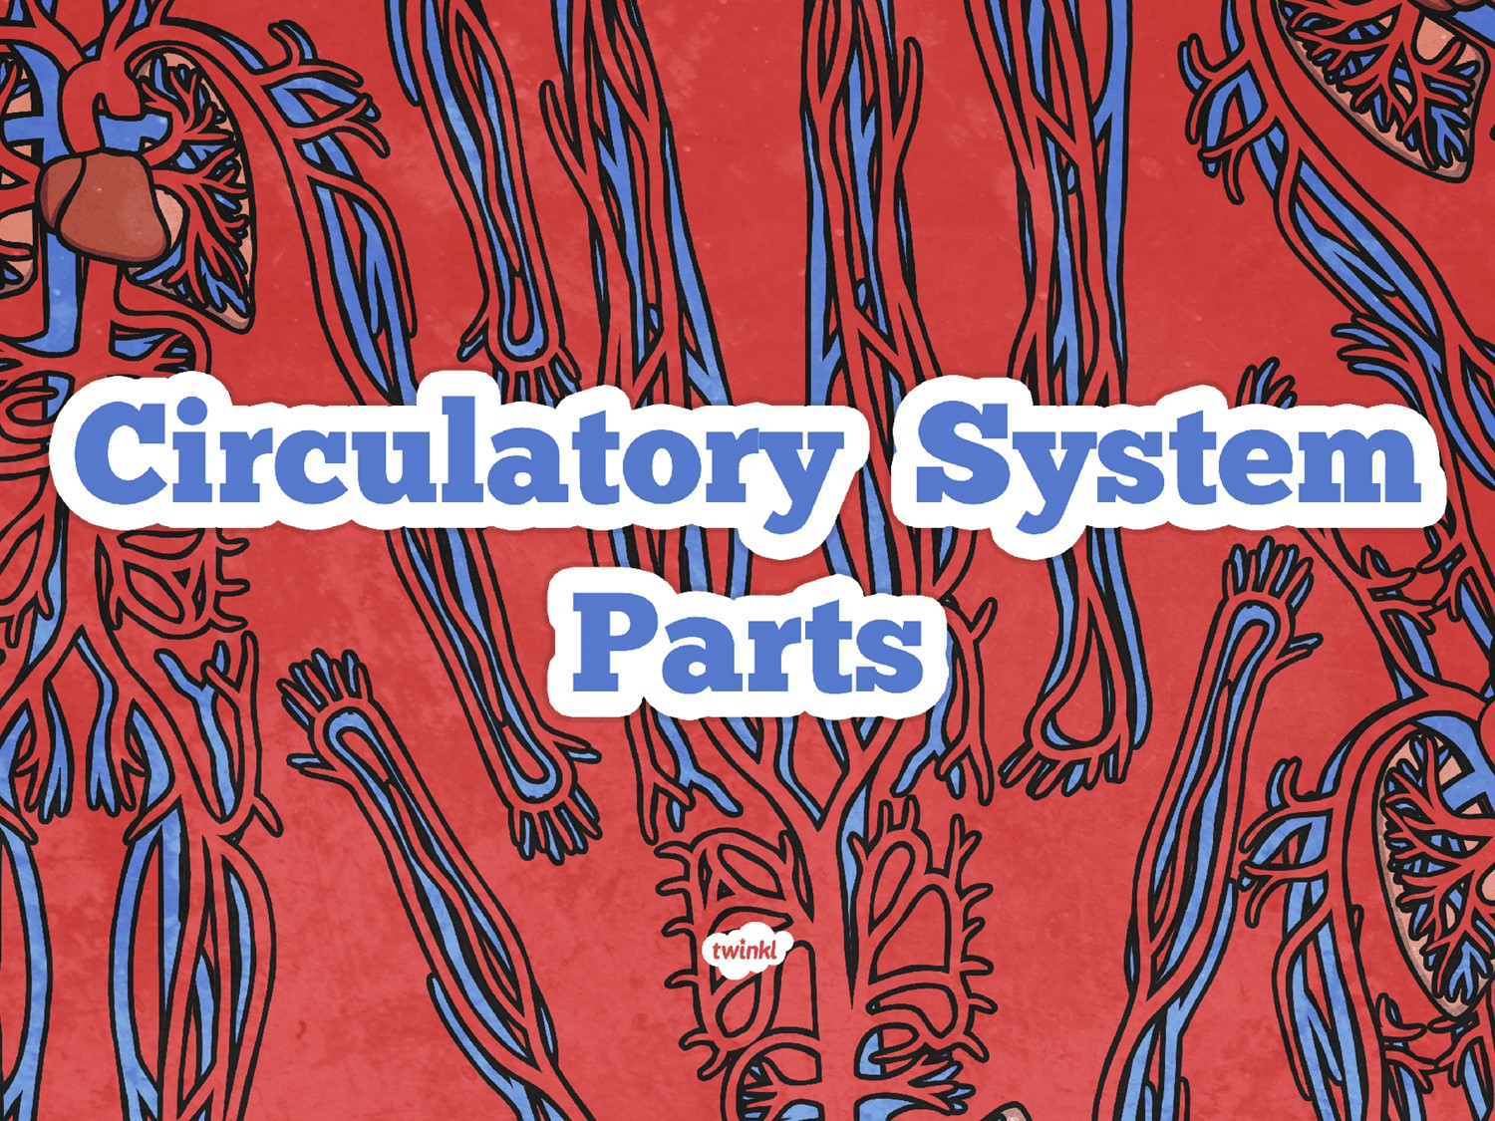
And skeleton recap!

Slide 3
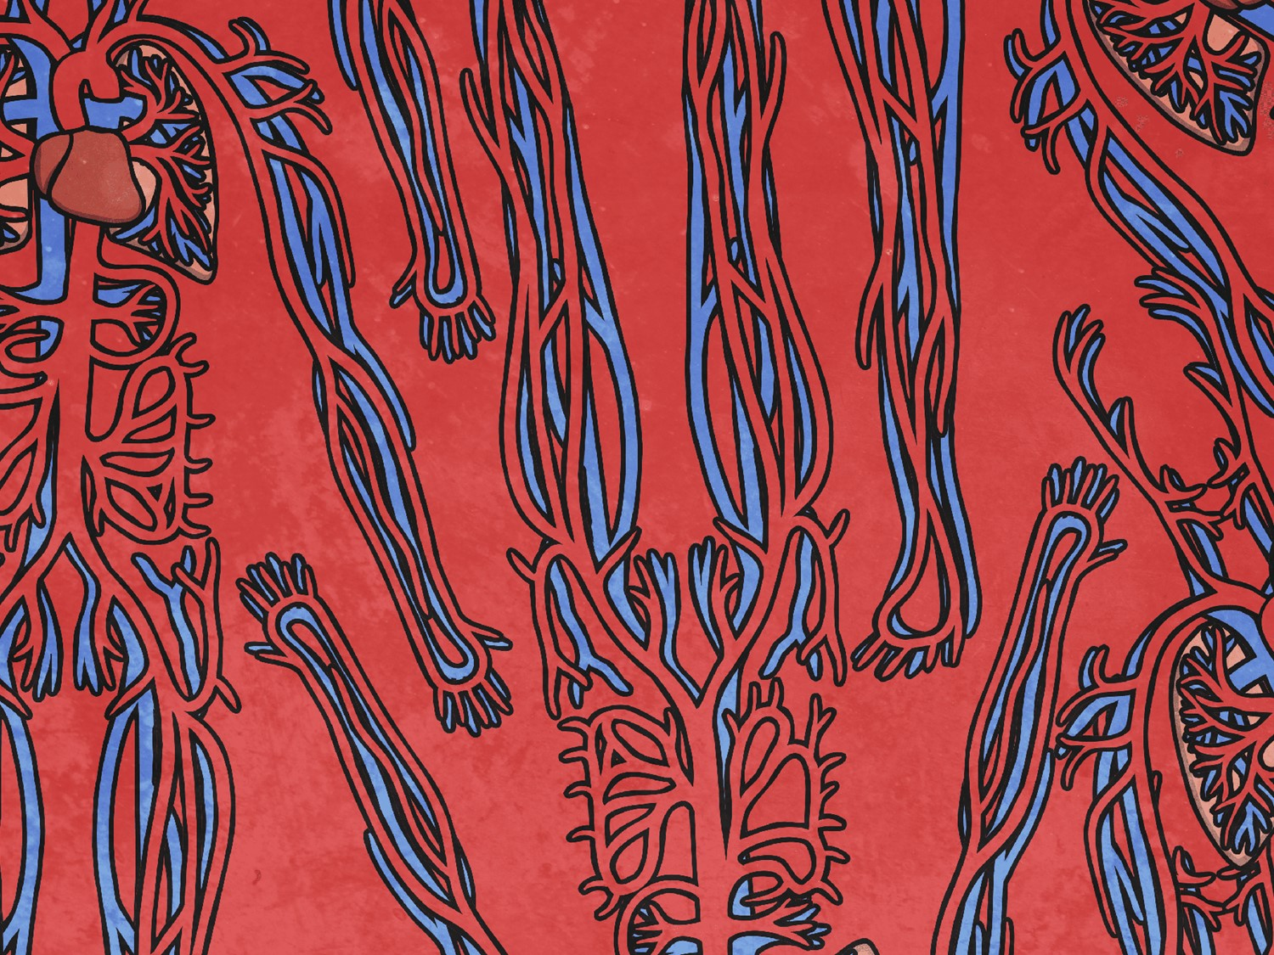
Before we start!
Look at page 11 of your booklet.
You have 5 minutes to see what you know!
Your time starts now!

Slide 4
Aim
To revise the bones of the body.
I can identify and name the parts of the human circulatory system.
Success Criteria
I can identify different bones in the human body and explain some of their functions.
I can identify the parts of the circulatory system.
I can name the parts of the circulatory system.

Slide 5

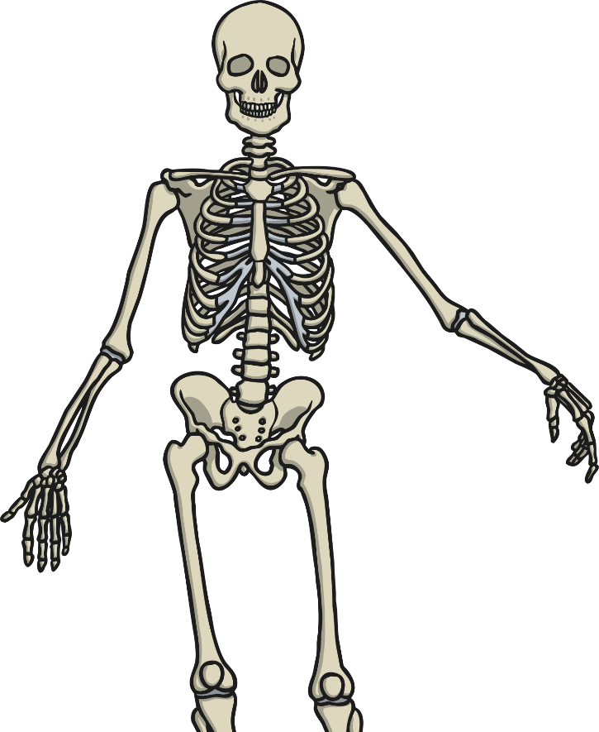
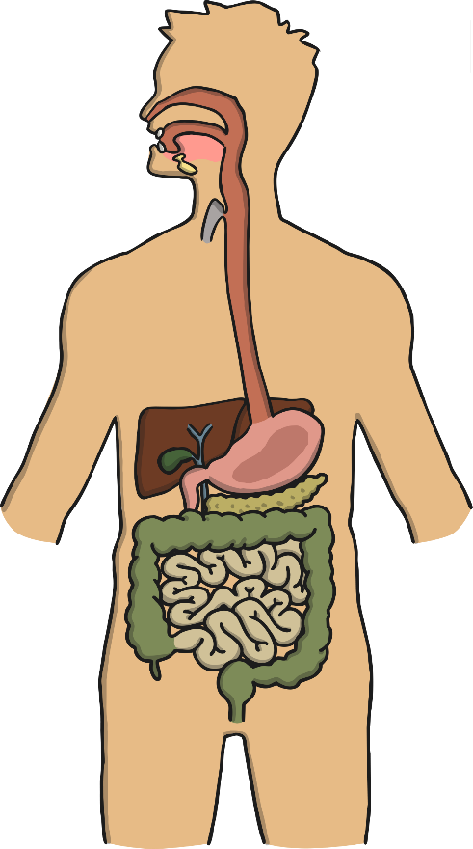
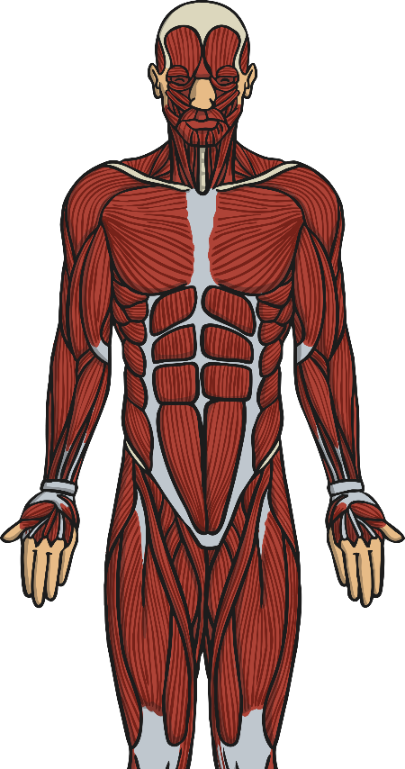
Systems in the Body: a Reminder
There are a number of systems in the human body. Look on page 1 of your booklet, can you recognise which is which?

Slide 6
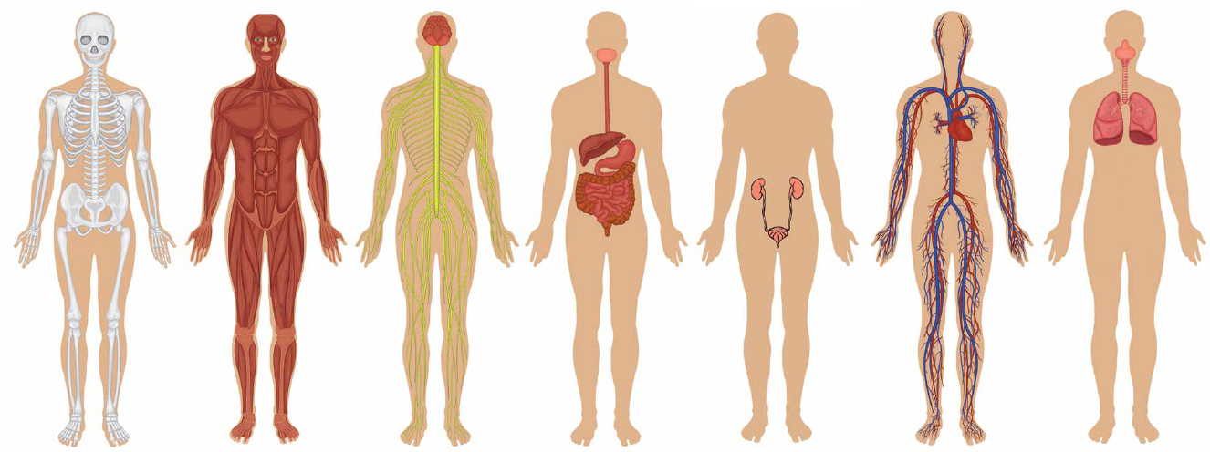
Systems in the Body: a Reminder
Page 1 answers
Skeletal system
Muscular system
Nervous system
Digestive system
Renal
system
Circulatory
system
Respiratory system

Slide 7
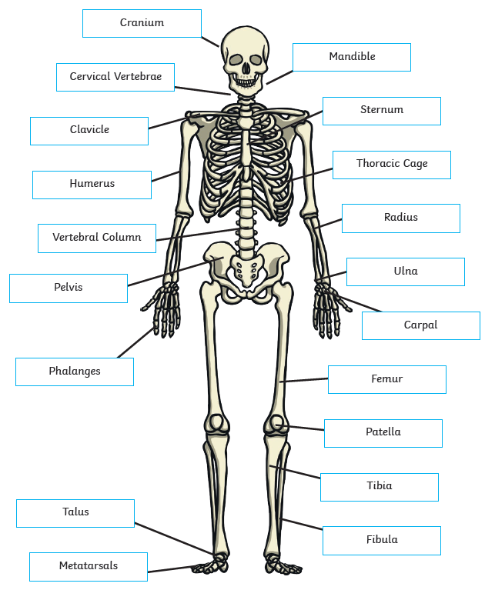
Systems in the Body: a Reminder – Skeletal system
Look at page 2 of your booklet. Can you remember what the bones in the body are called and some of their functions?
Click on the picture to see a labelled diagram of the skeleton.
To find out more, have a look at this interactive diagram of the human skeleton: https://www.dkfindout.com/uk/human-body/skeleton-and-bones/skeleton/
Click here to see diagram
Click on picture to hide

Slide 8

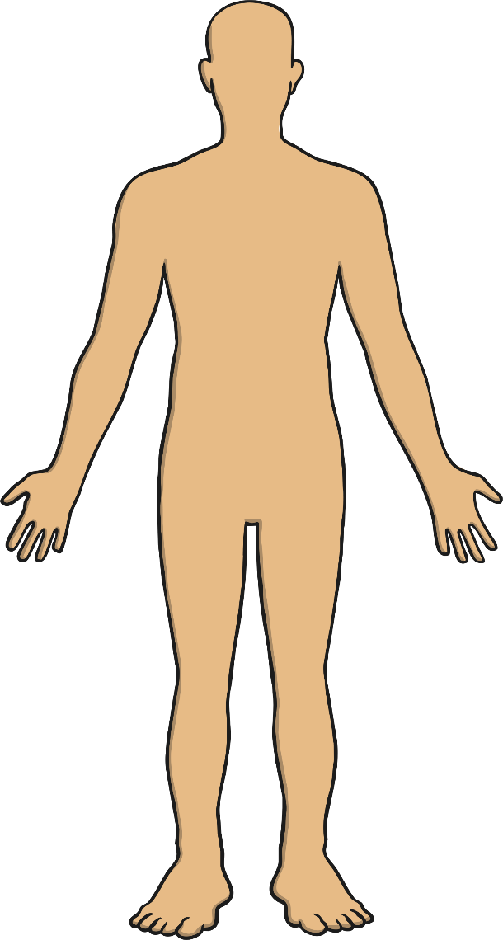

Systems in Your Body
The system we will look at for the rest of this lesson is called the:
‘Circulatory System’.
The word circulation means ‘the movement to, fro or around something’.
Have a think:
What do you think the system does?
Do you know the names of any parts of the system?

Slide 9

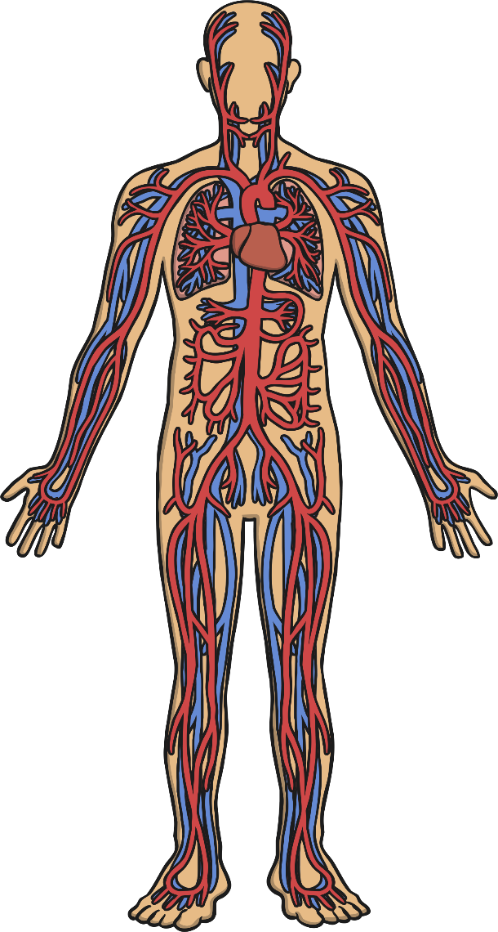
The Circulatory System
What can you see?
Is this what you expected?
Are there parts you did not expect to be in the circulatory system?

Slide 10
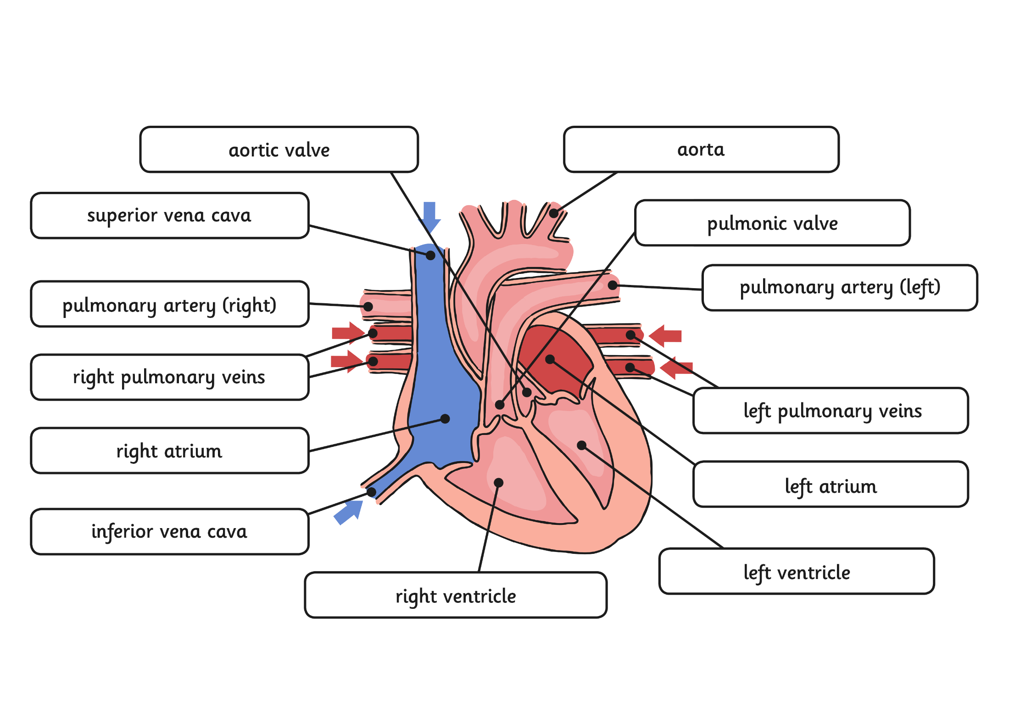
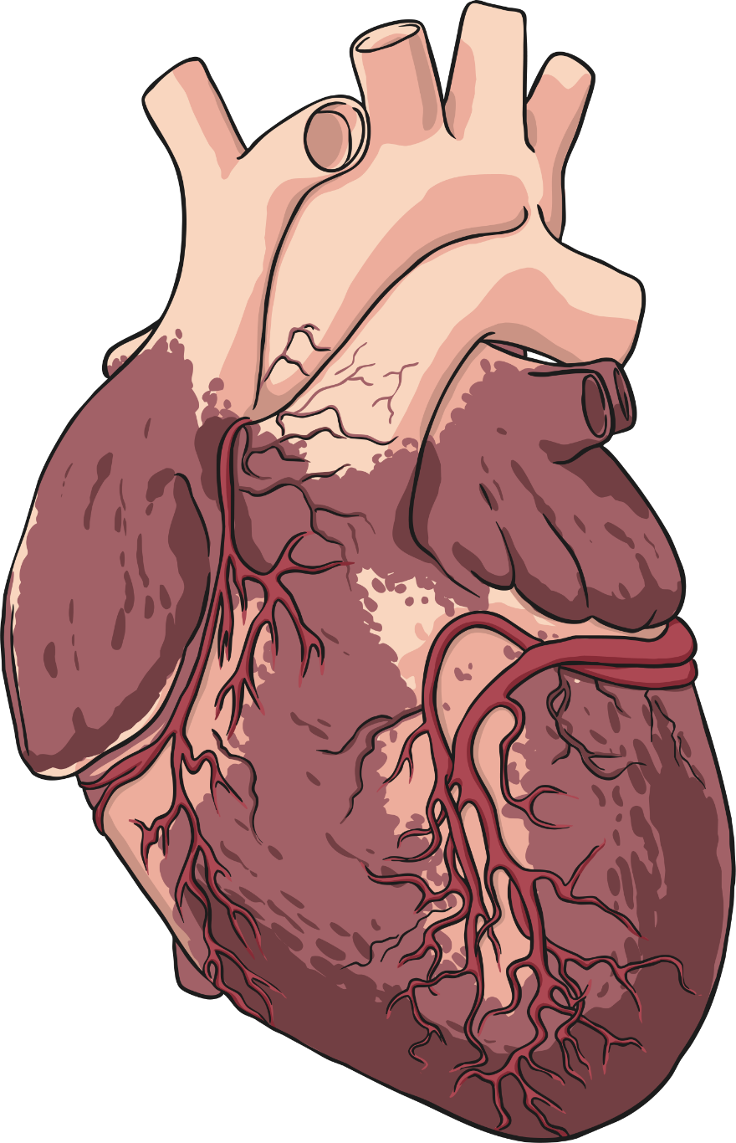


Parts of the Circulatory
System: Heart
The heart is a powerful organ that is situated between your lungs and protected by the ribcage.
The heart pumps blood to the lungs to get oxygen.
The heart then pumps this oxygenated blood around the body.
The heart is split between the left and right side.
As you can see, it consists of many parts!
Click me for a larger version!
Click anywhere to hide.
Click me for a larger version!
Click anywhere to hide.

Slide 11
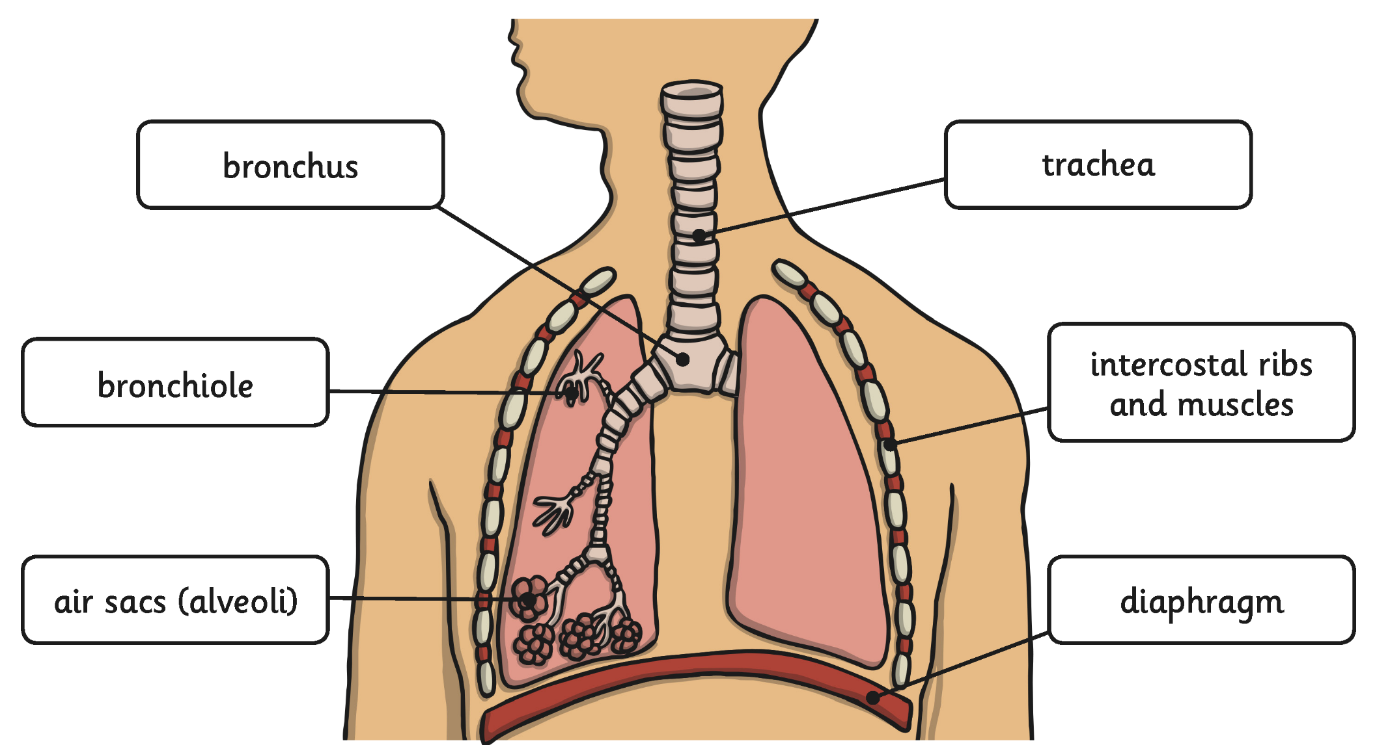

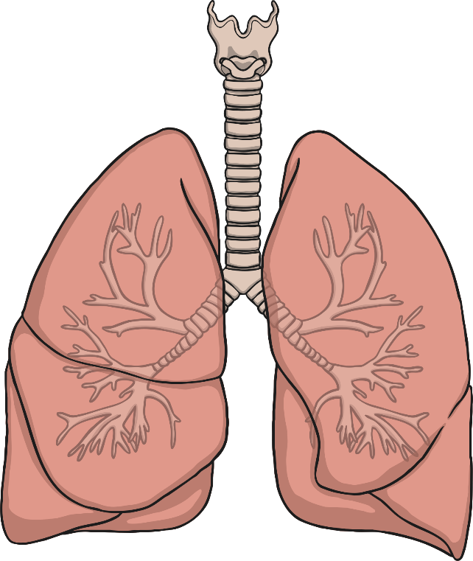
Parts of the Circulatory
System: Lungs
Click me for a larger version!
Air breathed in through the mouth or nose travels down the trachea, through the bronchi into one of the lungs. The air travels into the bronchioles and into the air sacs (alveoli). From here, the gas is able to pass in to the bloodstream.
Click anywhere to hide.

Slide 12
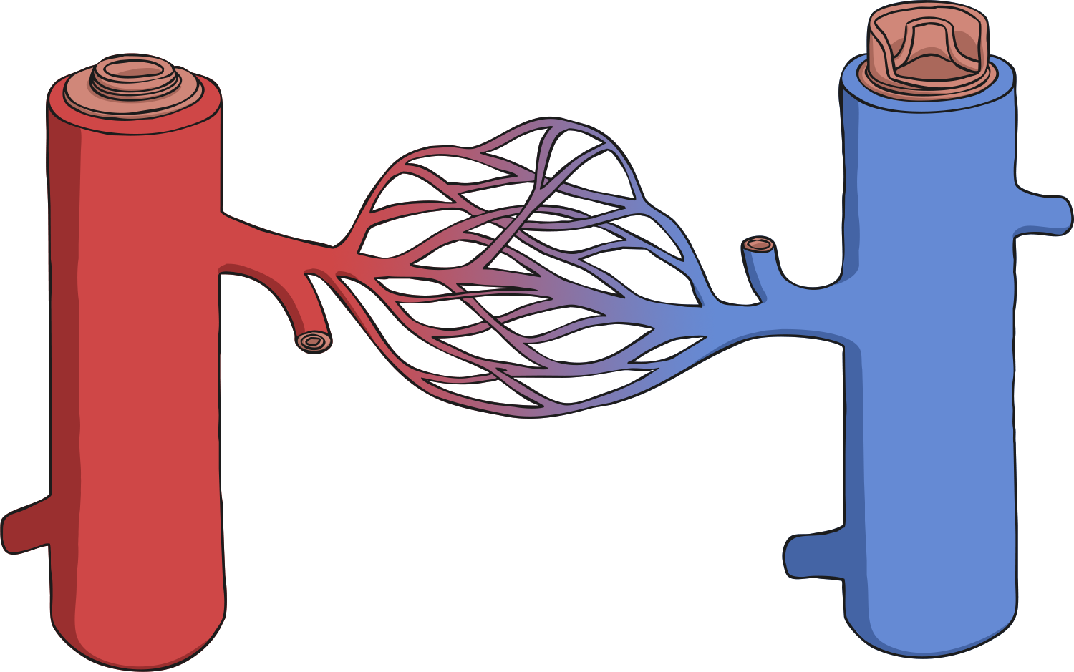
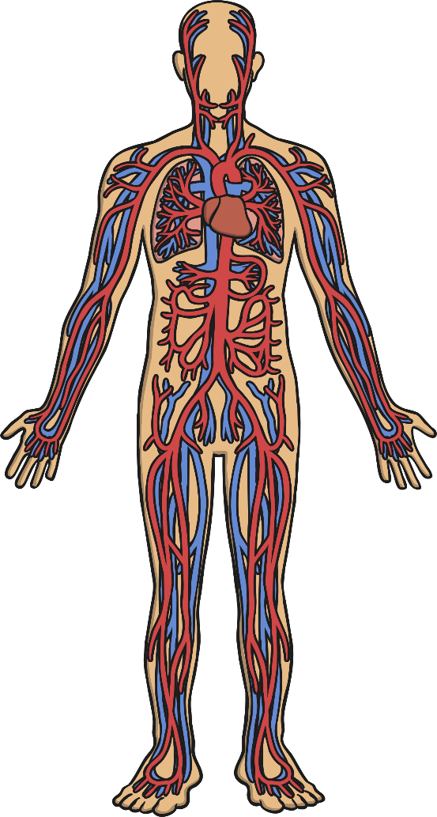
Parts of the Circulatory System:
Blood Vessels
vein
artery
capillaries
Blood vessels can be split into three types:
Arterial blood vessels - arteries:
Arteries are blood vessels that carry blood away from the heart.
Venous blood vessels - veins:
Veins are blood vessels that carry blood to the heart.
Capillaries:
These are the smallest blood vessels. Capillaries connect the arteries and the veins and are the place where water and chemicals exchange in the blood.
Click anywhere to hide.
Click here for a diagram that shows how the three blood vessels are linked.

Slide 13
Parts of the Circulatory
System
Complete page 3 in your booklet about the circulatory system.

