Slide 2



Diving into Mastery Guidance for Educators
Each activity sheet is split into three sections, diving, deeper and deepest, which are represented by the following icons:
These carefully designed activities take your children through a learning journey, initially ensuring they are fluent with the key concept being taught; then applying this to a range of reasoning and problem-solving activities.
These sheets might not necessarily be used in a linear way. Some children might begin at the ‘Deeper’ section and in fact, others may ‘dive straight in’ to the ‘Deepest’ section if they have already mastered the skill and are applying this to show their depth of understanding.
Diving
Deeper
Deepest

Slide 3
Aim
Solve problems involving the calculation of percentages and the use of percentages for comparison.

Slide 4

Percentage of an Amount (1)
Diving
1
Match the equivalent fractions and percentages.
50%
25%
1%
10%
1
1
1
1
1
100
1
2
1
10
1
4
2
4
100
10
2
What is the quickest way to find 50% of a number?
To find 50%, divide by two.
3
How can you use equivalent fractions to find 1%, 10% or 25% of a number?
Divide by the denominator of the equivalent fraction.
To find 1%, divide by 100.
To find 10%, divide by 10.
To find 25%, divide by 4.

Slide 5
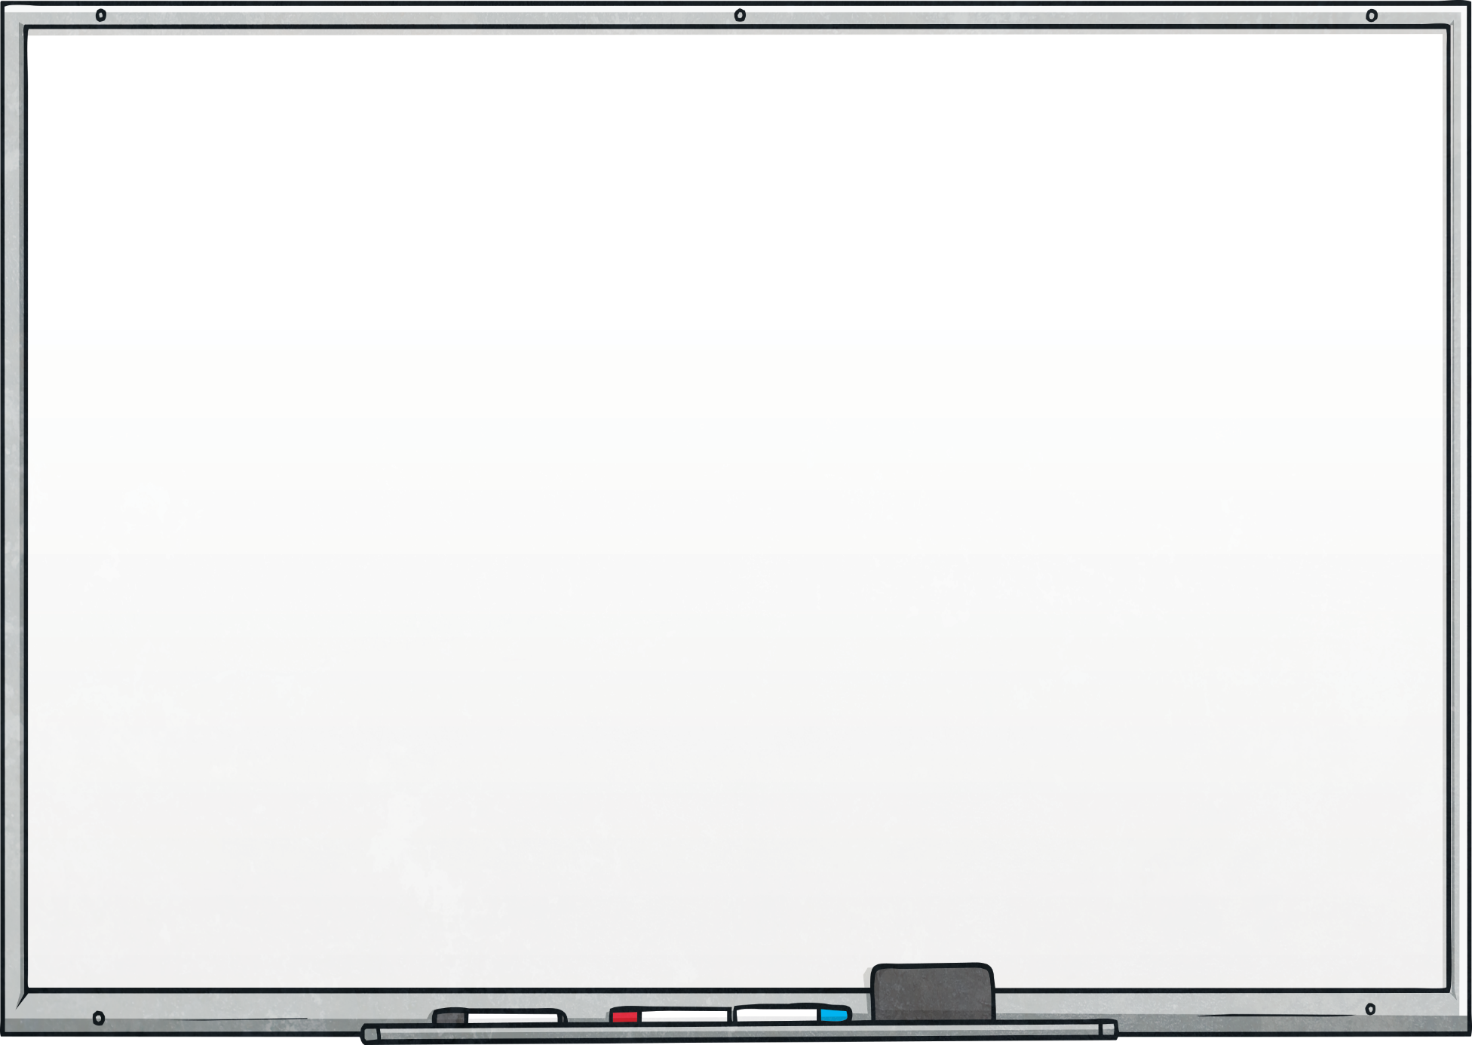
Percentage of an Amount (1)
Diving
4
Complete this diagram to show the percentages of 800.
100
400
÷
50% =
÷ 2
÷
2
800
80
8
10% =
1% =
÷ 10
÷
10
200
÷
4
25% =

Slide 6
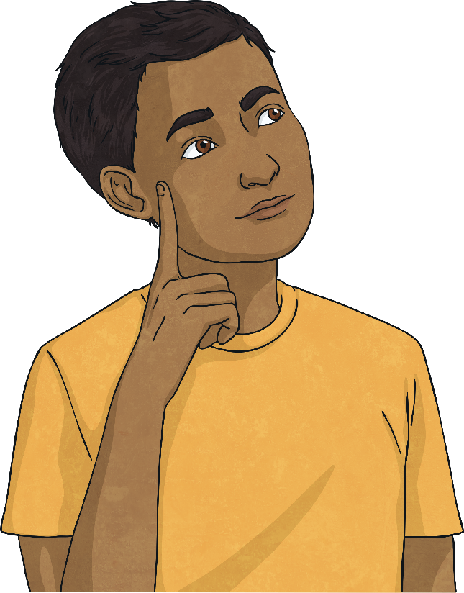
Percentage of an Amount (1)
Diving
5
Calculate the percentages of these different amounts.
50% of £750 = | 25% of 6.4km =
10% of 3m = | 1% of 4kg =
£
m
cm
g

Slide 7


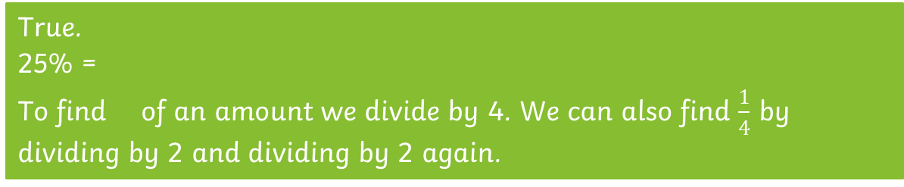
Percentage of an Amount (1)
Deeper
True or False?
To find 25% of an amount I can divide the amount by 2 and then divide it by 2 again.
True.
25% =
To find of an amount we divide by 4. We can also find $\frac{1}{4}$ by dividing by 2 and dividing by 2 again.
1
4
1
4
10% of 240 = 1% of 2400
True.
240 ÷ 10 = 24 is the same as 2400 ÷ 100 = 24
25% of 4680 < 50% of 2280
False
25% of 4680 = 1170 and 50% of 2280 = 1140
1170 > 1140
25% of 4680 > 50% of 2280

Slide 8

Percentage of an Amount (1)
Deepest
Choose a percentage from box A and an amount from box B then complete the percentage statement to make each of the numbers from C.
A | B
10%, 1%, 50%, 25% | 3000, 300, 30, 70, 700, 7000, 450, 4500, 680, 6800
Percentage from A |  | Number from B |  | Percentage from A |  | Number from B |  | Number from C
% | of |  | + | % | of |  | =
C
10 | 500
1200 | 3700
A number between 500 - 800
(1% of 300 + 1% of 700)
(50% of 300 + 50% of 700)
(25% of 4500 + 25% of 300)
(50% of 6800 + 10% of 3000)
(25% of 680 + 50% of 700 = 520)
Example answers are shown.

Slide 9


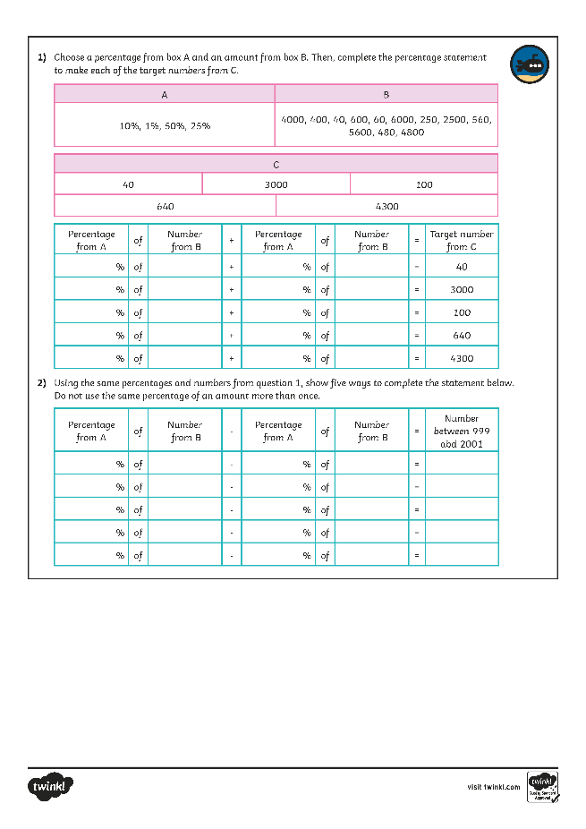
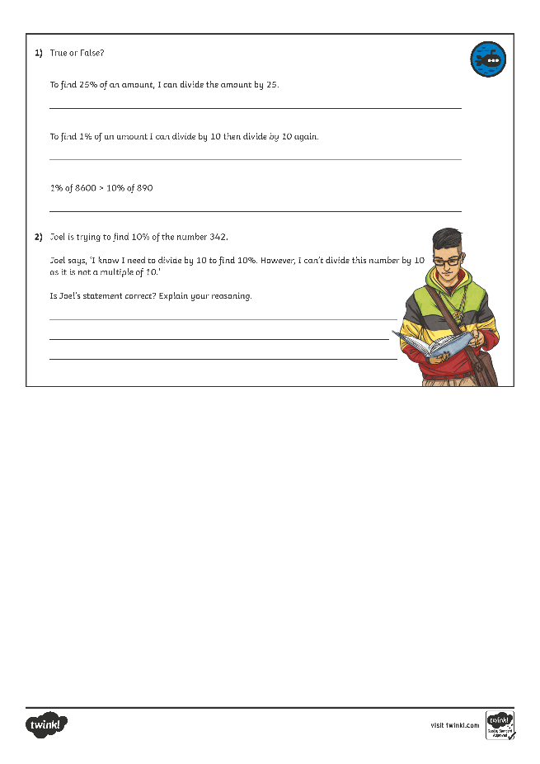
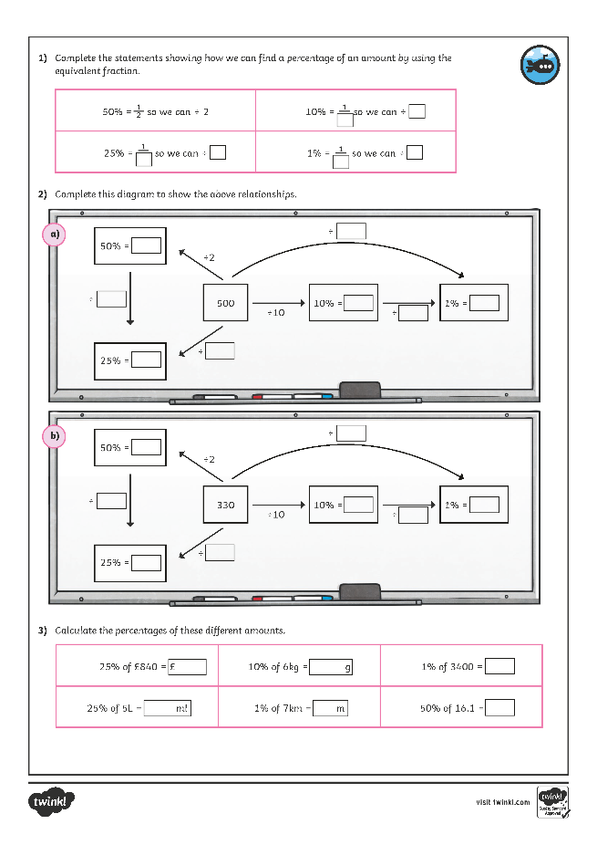
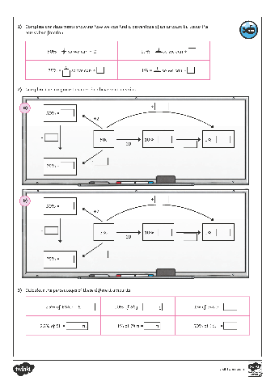
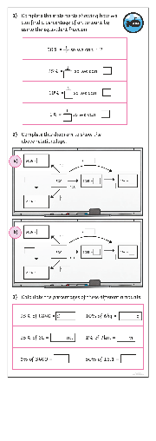
Percentage of an Amount (1)
Dive in by completing your own activity!

Slide 10
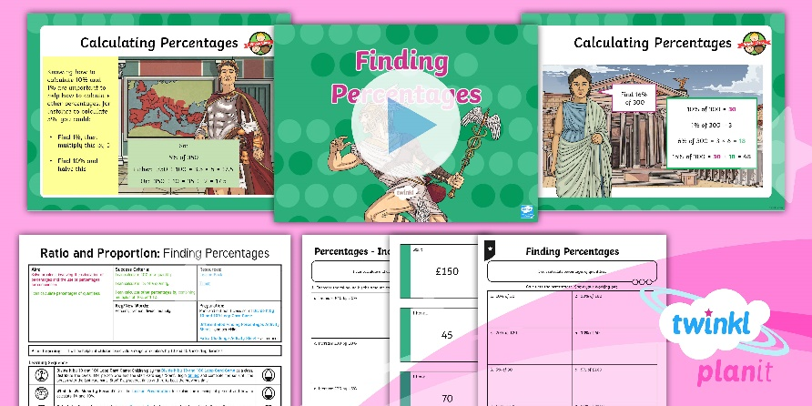
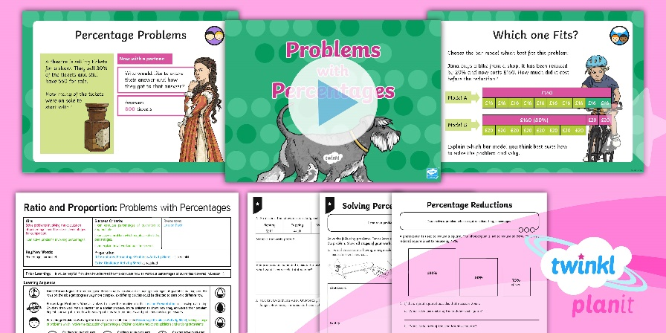

Need Planning to Complement this Resource?
National Curriculum Aim
Solve problems involving the calculation of percentages and the use of percentages for comparison.
For more planning resources to support this aim, click here.
Twinkl PlanIt is our award-winning scheme of work
with over 4000 resources.

