Slide 1


Art and Design
South and Central American Art
Year One
Art | UKS2 | South and Central American Art | Making Picture Puzzles | Lesson 2

Slide 2



Slide 3
Aim
I can tell you about the artist Joaquin Torres Garcia.
I can paint symbols.
Success Criteria
I can tell you the names of some of Joaquin Torres Garcia’s artworks.
I can tell you facts about Joaquin Torres Garcia’s life and work.
I can share something interesting about his work.
I can choose 4 symbols that mean something to me.
I can paint my symbols onto paper rectangles.
I can arrange my paper squares and stick them down.

Slide 4
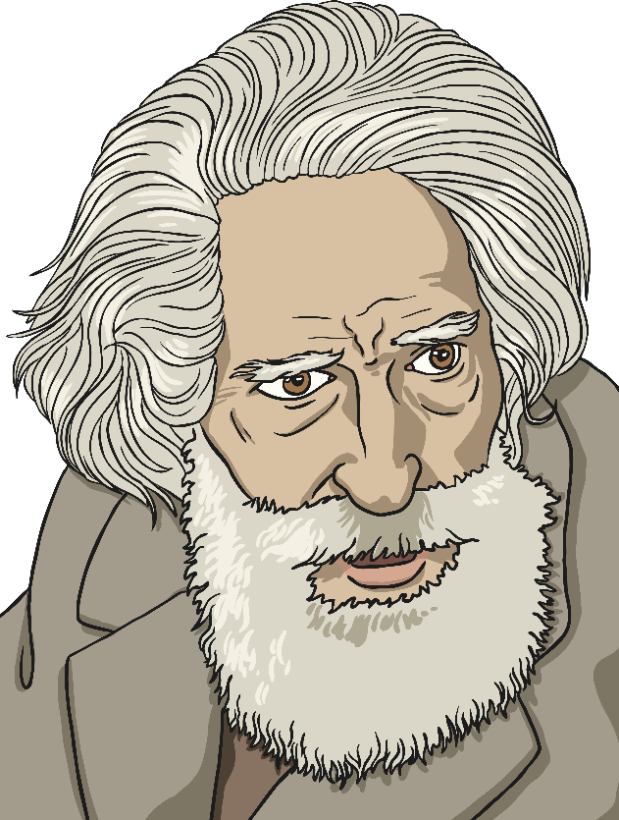
Joaquin Torres Garcia

Slide 5
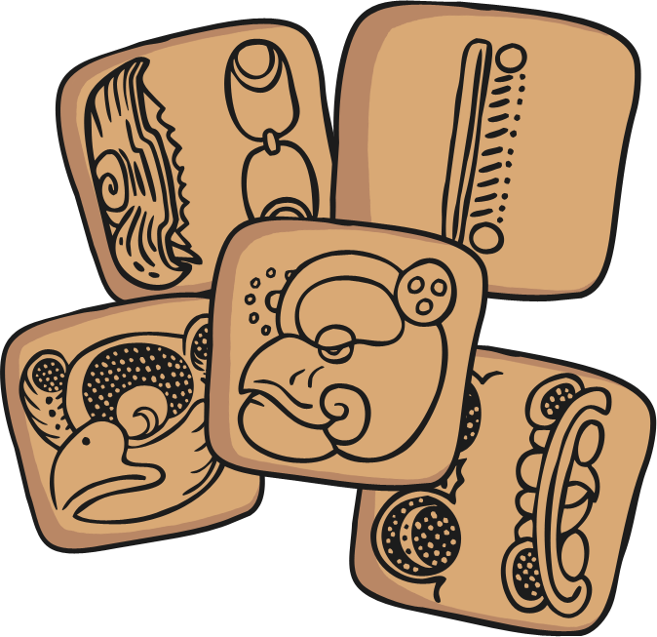
Joaquin Torres Garcia
(1874-1949)
Torres Garcia was famous for using symbols in his artworks. He made toys, paintings and sculptures.
His biggest influences were the artist, Mondrian and ancient people such as the ancient Greeks and Egyptians. Ancient people used symbols to tell stories and record information. Torres Garcia used this as a way of communicating his ideas too.
Torres Garcia wanted his work to look flat, on a grid.
He preferred earthy colours and used symbols from music, religion, horoscopes, traffic, technology and ancient cultures.

Slide 6

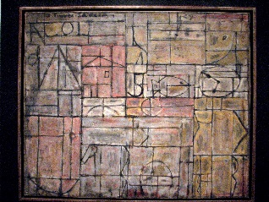
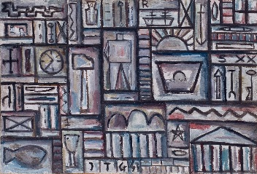
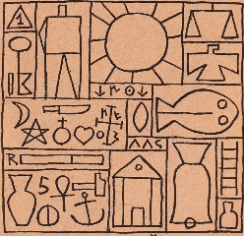
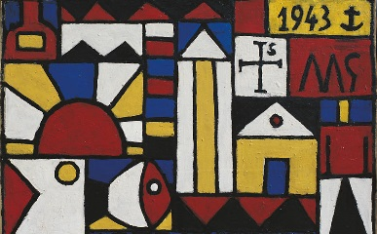
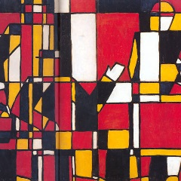
Looking at Art
Look at your image.
What can you see in the picture?
Look at the symbols in the painting. Do you recognise any? What might they mean?
What kind of colours has the artist used?
How does the picture make you feel?
Why do you think the artist painted it?

Slide 7
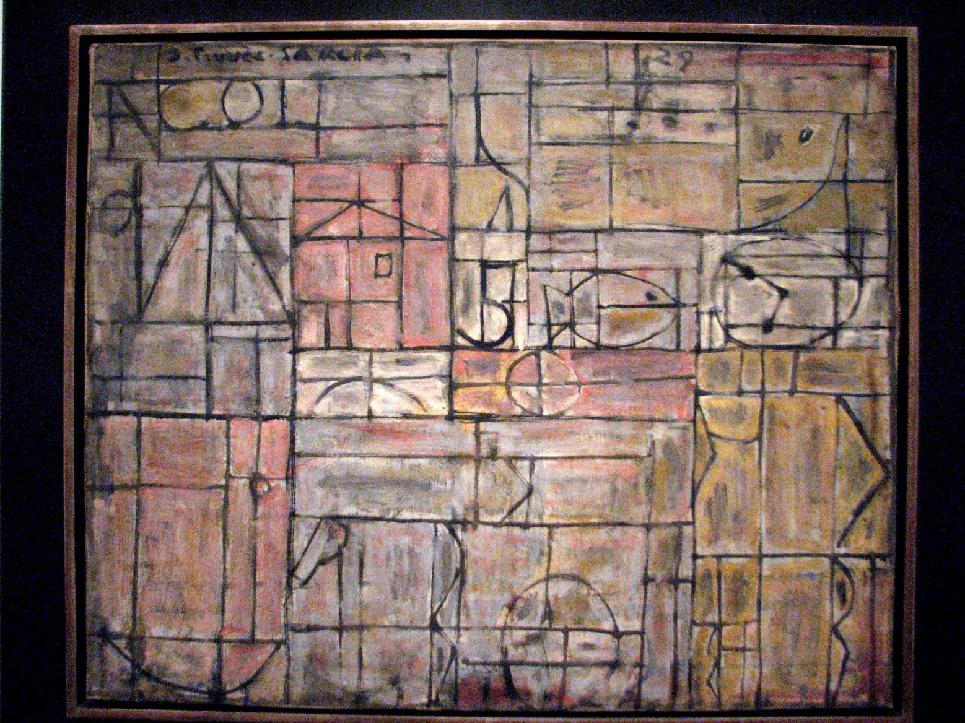
Unknown
by Joaquin Torres Garcia
Photo courtesy of bobistraveling (@flickr.com) granted under creative commons licence - attribution

Slide 8
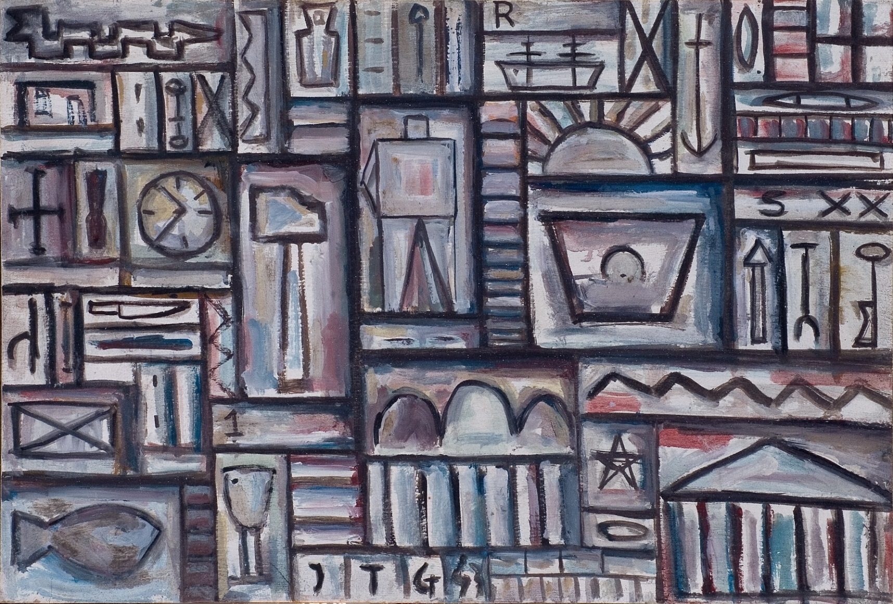
Construcción
by Joaquin Torres Garcia
Photo courtesy of culturaargentina (@flickr.com) granted under creative commons licence - attribution

Slide 9
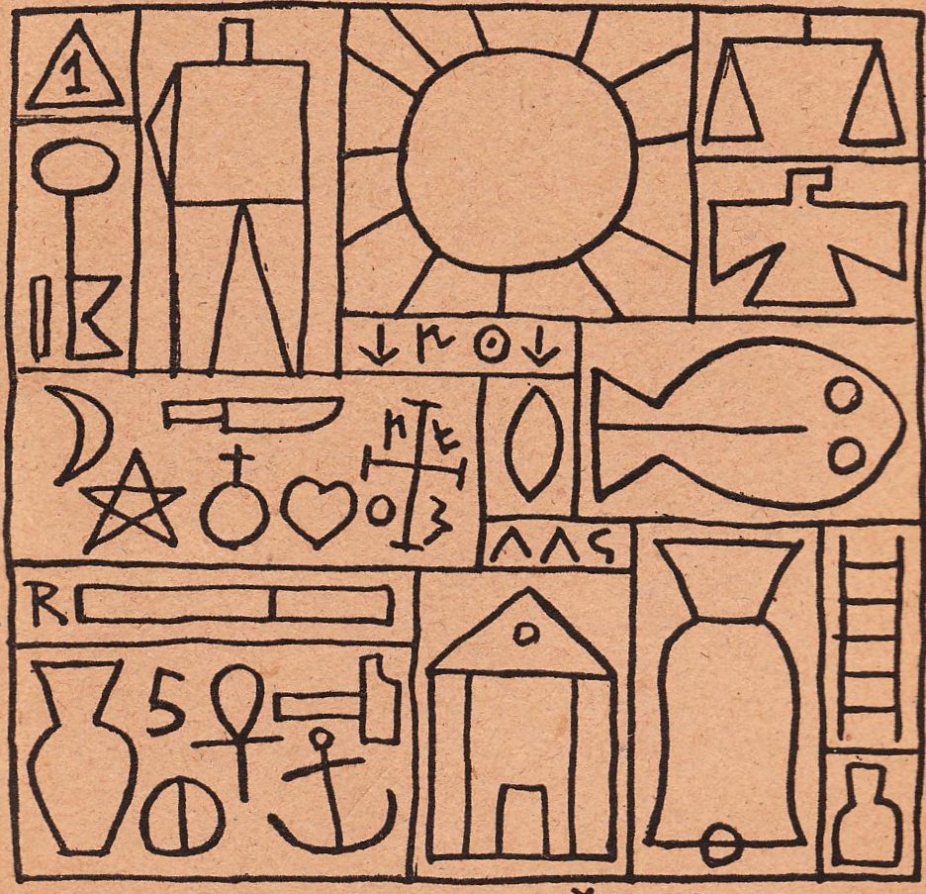
Doctrina Constructivista
by Joaquin Torres Garcia
Photo courtesy of migueloks (@flickr.com) granted under creative commons licence - attribution

Slide 10
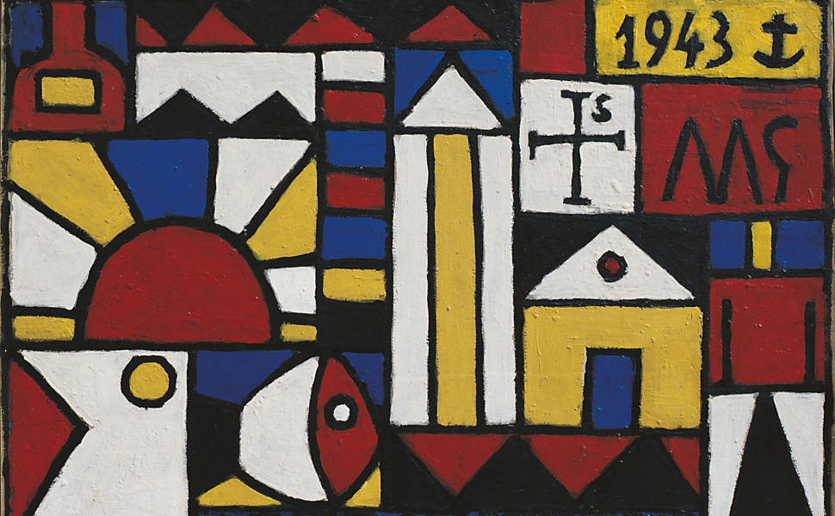
Arte Constructivo
by Joaquin Torres Garcia
Photo courtesy of www.wikiart.com - attribution

Slide 11

Figuras a Cinco Colores
by Joaquin Torres Garcia
Photo courtesy of www.wikiart.com - attribution

Slide 12

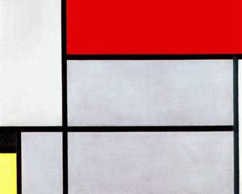
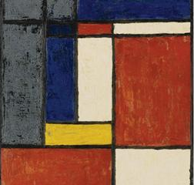
Comparing Mondrian to
Torres Garcia
Torres Garcia always explained that Mondrian had been a big influence on his work. What do you think?
Find a difference and a similarity between the works.
This painting was completed in 1921 by Mondrian.
This painting was completed in 1929 by Torres Garcia.
Photo courtesy of www.wikiart.com - attribution

Slide 13

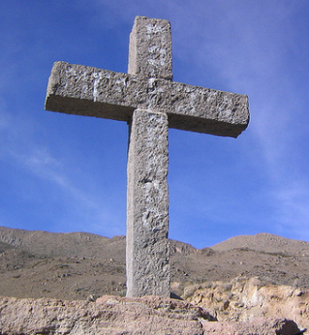

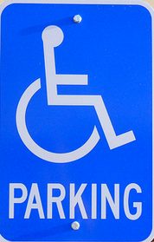
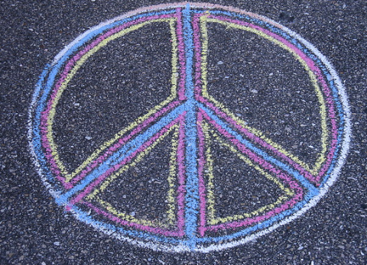
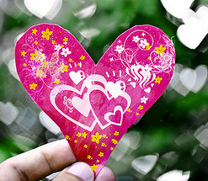


Match the Symbols
Torres Garcia used signs and symbols throughout most of his work.
To find out how important signs and symbols are as a way of communicating in everyday life, match the symbol to the meaning:
@

Slide 14
Answers - Match the Symbols
Christianity
Fast Food
Disabled
Parking
Peace
@
Love
Toilets
Warning
At

Slide 15

Thinking about Yourself
Instructions: You are going to paint four small pictures that represent yourself.
Use a whiteboard to try and answer these questions.
They will help you to decide what your four pictures might be:
What object is most important to you?
What is your best or funniest memory?
Who would you take with you if you won an amazing holiday?
When you are not at school, what do you enjoy doing most?

Slide 16

Turning your Ideas into Symbols
Your answers might look like this:
My Trophy
My Dad’s dancing at a wedding.
My family.
When you are not at school, what do you enjoy doing most?
Turn your answers into simple pictures (symbols).
What will you paint?

Slide 17

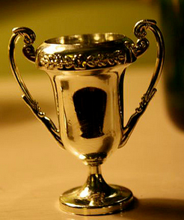
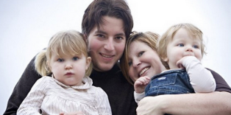
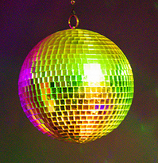
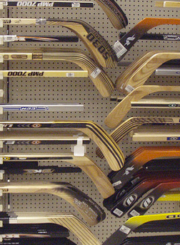
What a Good Picture Puzzle Looks Like…
Photo courtesy of sisterwisdom, pinkmoose, infomaster, Julie rybarczyk (@flickr.com) granted under creative commons licence - attribution

Slide 18
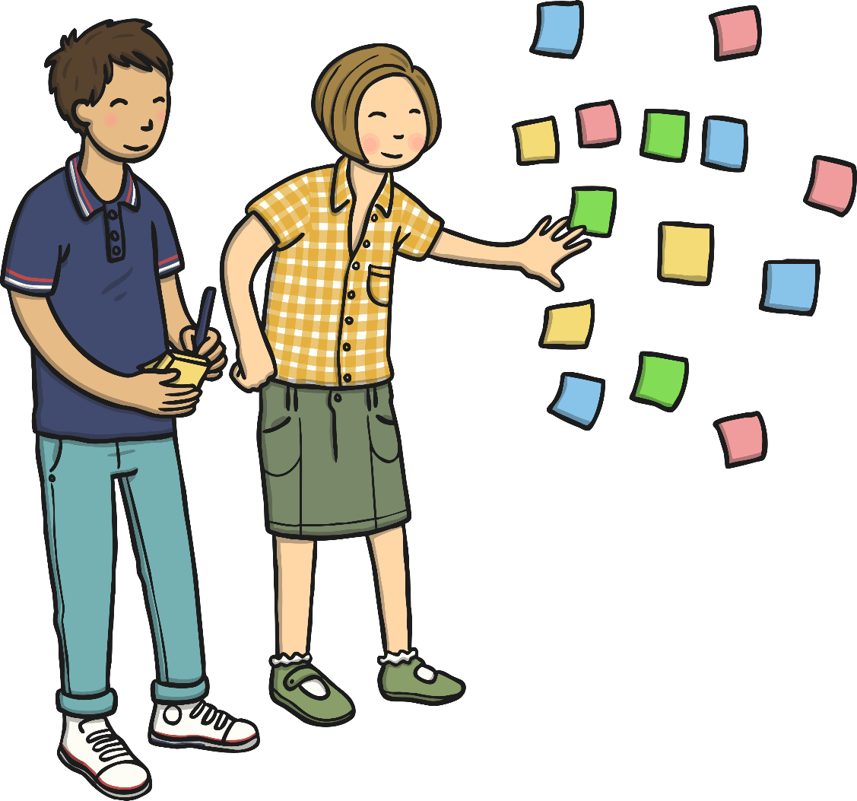
Symbol Solving
On your sticky note, list the four symbols you used today.
Write your name on the back of the sticky note.
See if you can match the symbols to one of your classmates.

Slide 19

Aim
I can tell you about the artist Joaquin Torres Garcia.
I can paint symbols.
Success Criteria
I can tell you the names of some of Joaquin Torres Garcia’s artworks.
I can tell you facts about Joaquin Torres Garcia’s life and work.
I can share something interesting about his work.
I can choose 4 symbols that mean something to me.
I can paint my symbols onto paper rectangles.
I can arrange my paper squares and stick them down.

