Slide 1


Science
Animals Including Humans
Year One
Science | Year 6 | Animals Including Humans | Healthy Lifestyle | Lesson 4

Slide 2
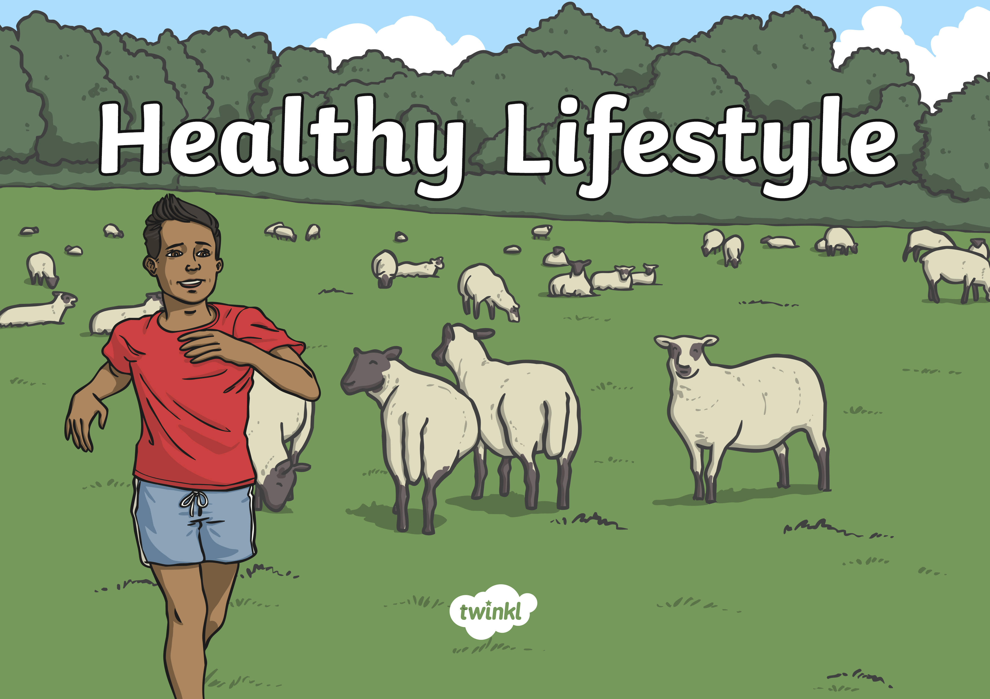

Slide 3
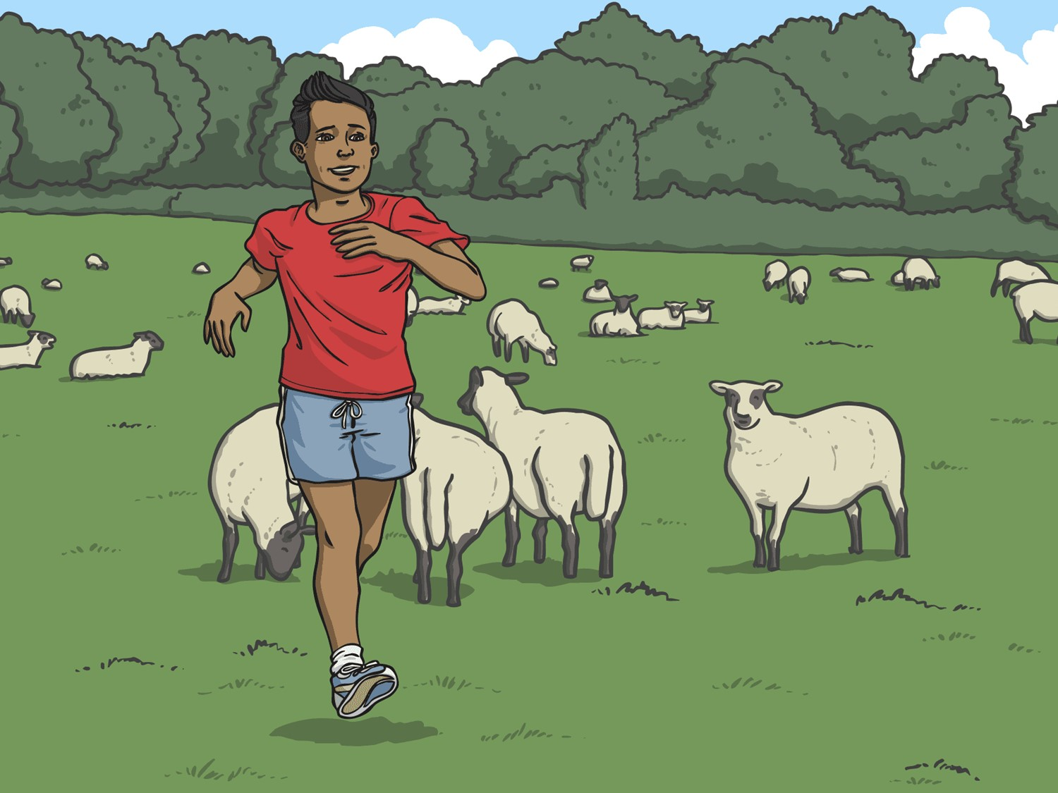
Aim
I can describe how diet and exercise impact on human bodies.
Success Criteria
I can identify what a healthy lifestyle consists of.
I can describe the impact of diet and exercise on the human body.

Slide 4

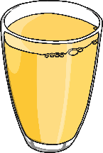
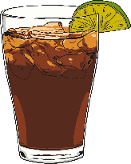
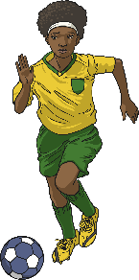

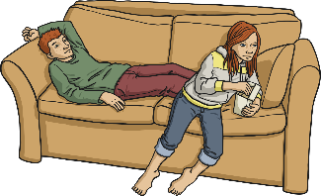
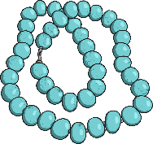
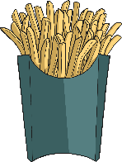
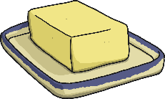

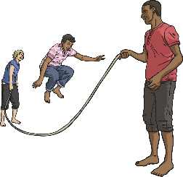
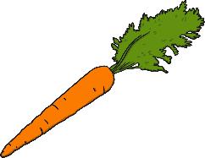
Healthy Lifestyle
Healthy
Unhealthy

Slide 5
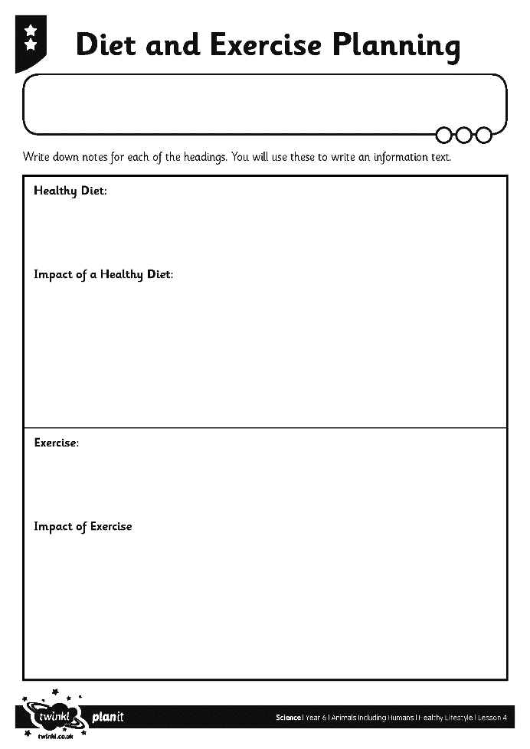
How to Have a Healthy Lifestyle
We are going to find out what the body needs to stay healthy.
Take notes on your Diet and Exercise Planning Sheet.

Slide 6
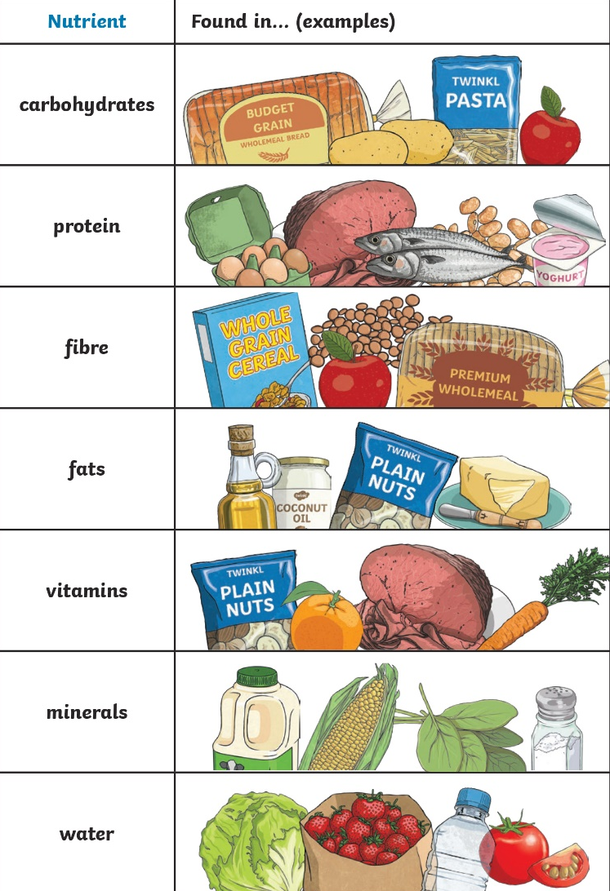
What is a Healthy Diet?
Healthy Diet:
A healthy diet involves eating the right types of nutrients in the right amounts. This is also called a ‘balanced diet’. Each of these nutrient types should be consumed over the course of each day but not necessarily at each meal!
One way to make sure that you eat a healthy diet is to ensure that you eat a variety of different foods. There may be certain foods that you don’t like, but make sure that you find alternatives or substitutes so that your diet is still balanced.
Unhealthy Diet:
An unhealthy diet is one which is not balanced – too much of some nutrient groups are eaten and not enough of the others. It is recognised that eating too much fat is bad for humans, however it needs to be remembered that eating, say, apples all day every day is not healthy either!!

Slide 7
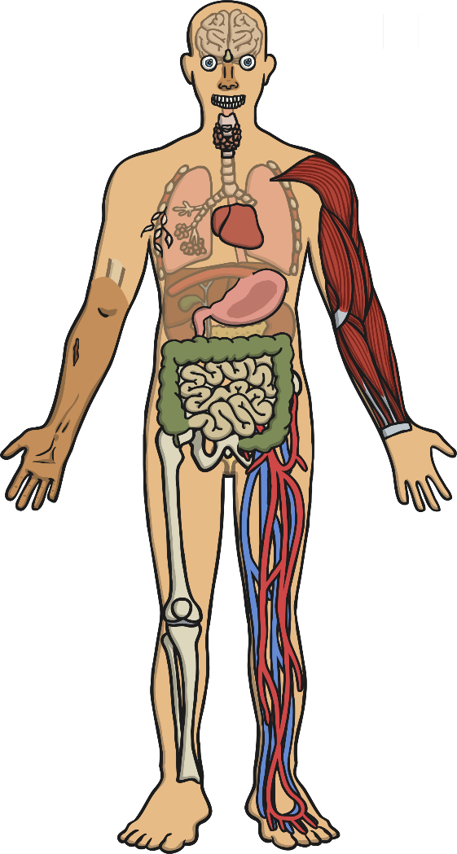
How to Have a Healthy Lifestyle
What Is the Impact of a Healthy Diet?
Carbohydrates give all cells energy. It also protects your muscles because if the body does not have enough energy it has to the use the protein tissues in muscles instead. This weakens muscles in the body.
Fats are needed for every cell membrane - the membrane holds the cell together. Brain tissue is rich in fat. Fat is used to create hormones.
Water half the weight of a human body is water! You can survive without food for longer than you can water. 92% of the volume of blood is water! Without blood your body would not be able to transport nutrients and oxygen.
Water helps control your temperature via sweating.
Proteins are needed to create muscles and organs.
Fibre: Keeps your bowels - which include your large intestine healthy.
Protein is needed to make haemoglobin – the part of the red blood cells that carry oxygen.

Slide 8
How to Have a Healthy Lifestyle
What Is the Impact of a Healthy Diet?
Vitamin A is needed to keep skin and linings of some body parts (like the nose) healthy. It is also needed to help eyes see in dim light.
Mineral: Calcium is needed for your bones to strengthen. It is also needed to regulate your heartbeat.
Vitamins B (there are several types) are needed to make red blood cells.
Mineral: Iodine keeps your skin, hair and nails healthy. It also keeps your thyroid gland – which controls how your body uses energy - working.
Vitamin C is needed to regenerate skin cells.
Mineral: Copper – that's right, the metal! The type that you eat is present in foods like raisins, chocolate and seafood! It helps form red blood cells and a lack of it affects the whole body.
Vitamin D is essential as without it bones and teeth can’t absorb calcium. A diet without it leads to soft bones in children (rickets) and misshapen ones in adults (osteomalacia).
Mineral: Iron - like copper, it is a metal that you consume through food like spinach. It is used to make enzymes (point to small intestine and stomach) and protein created by the human body by itself.
Vitamin K is needed to make blood clot – for example when you have a cut your blood clots. This is a result of the cells sticking together. This stops the body bleeding.
Mineral: Salt is needed to balance water in your body tissues and blood.

Slide 9
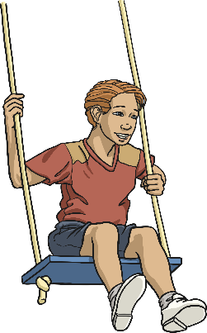
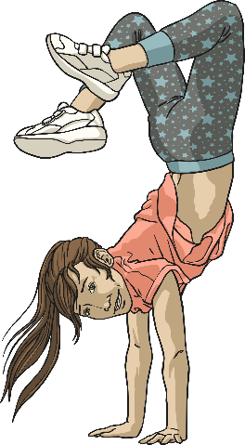
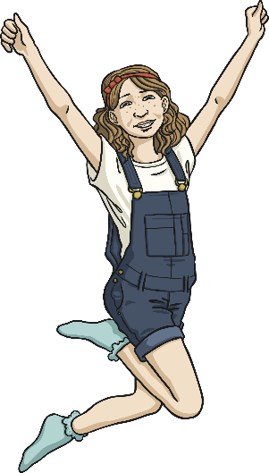
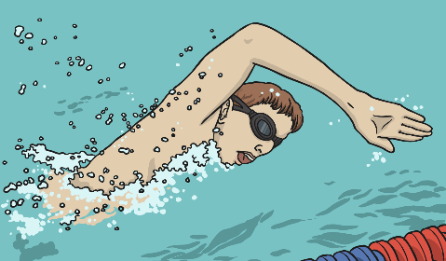
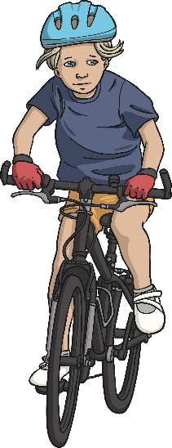
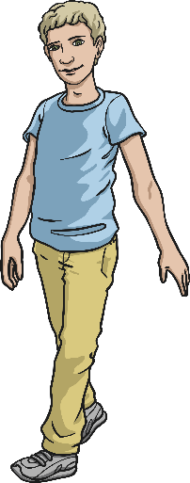
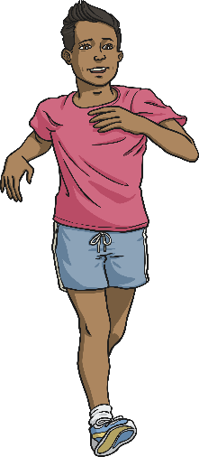
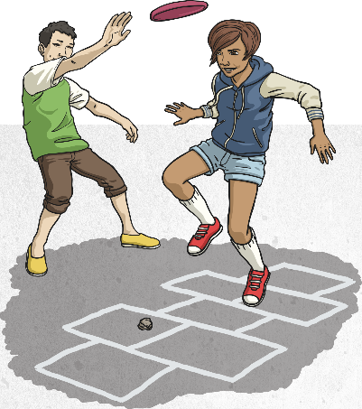
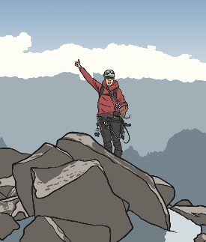
What Counts as Exercise?
Exercise is physical activity that requires effort, raises your heart rate and works your muscles.
There are two main types of exercise:
Muscle Strengthening | Bone Strengthening
 | Moderate Intensity | Vigorous Intensity

Slide 10
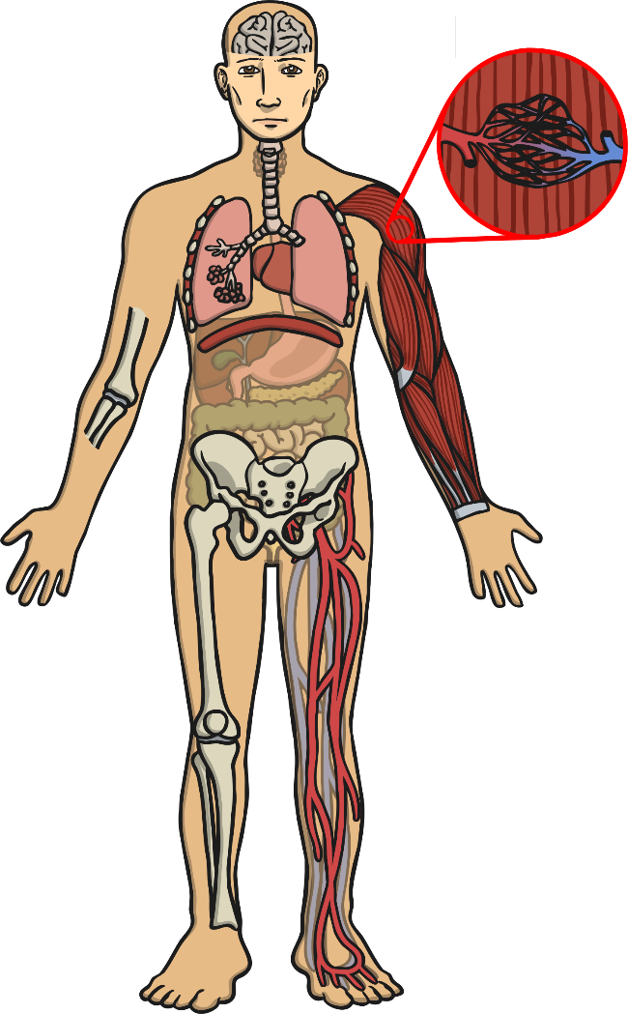
What Is the Impact of Regular Exercise?
Helps you fall asleep faster and deeper so you are better rested.
Increases the number of capillaries in the muscles.
Stimulates and releases brain chemicals – for example endorphins leave you feeling happier and serotonin helps keep your mood calm and leaves you feeling relaxed.
Strengthens heart muscle.
Strengthens diaphragm and intercostal muscles.
Increases the number of air sacs (alveoli).
Strengthens muscles.
When you exercise your body increases the circulation of blood – this means that nutrients are delivered and waste taken away faster which improves parts of the body like skin.
Increases the amount of oxygen delivered to and carbon dioxide removed from the body.
Joints are more stable.
Bones increase in width and density (The denser the bone, the stronger it is).
Increases the volume of blood and red blood cells.

Slide 11

The Impact of Diet and
Exercise: Research
You are going to do your own research on the impact of diet and exercise on a healthy lifestyle.
Record your findings on your planning sheet.

Slide 12
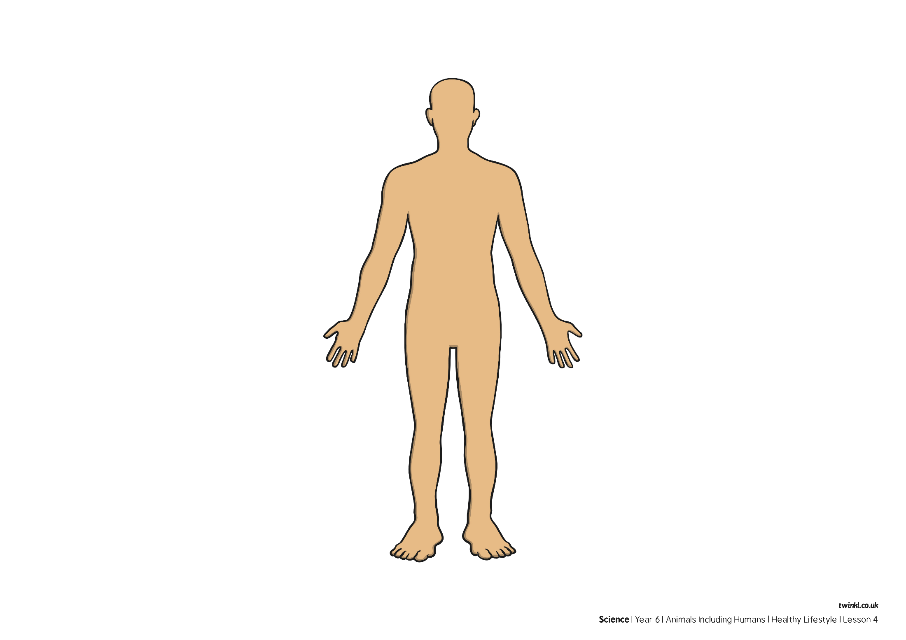
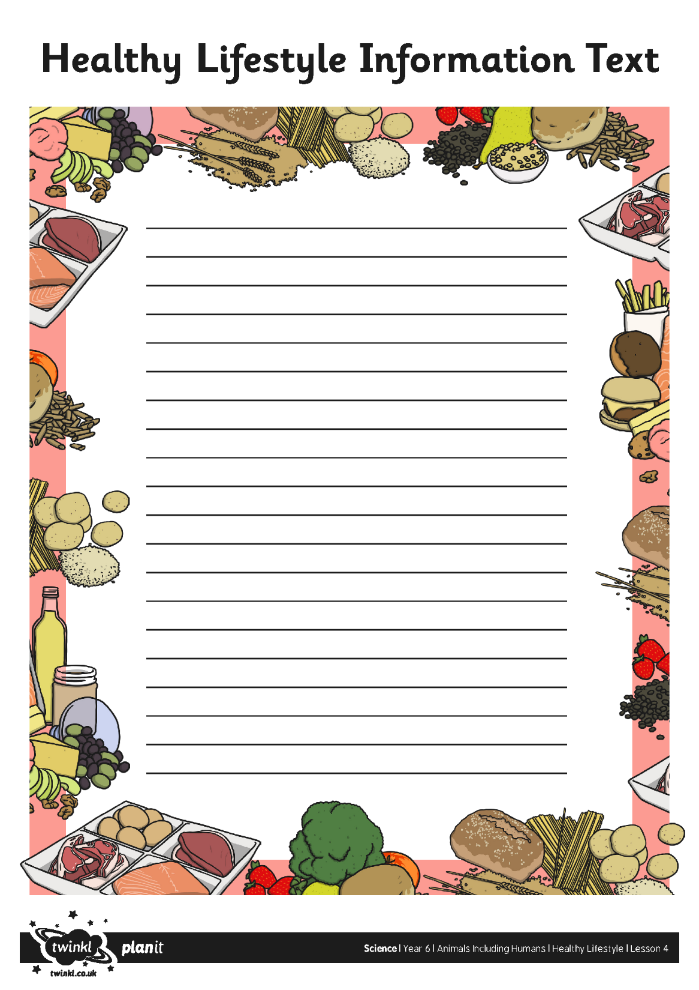
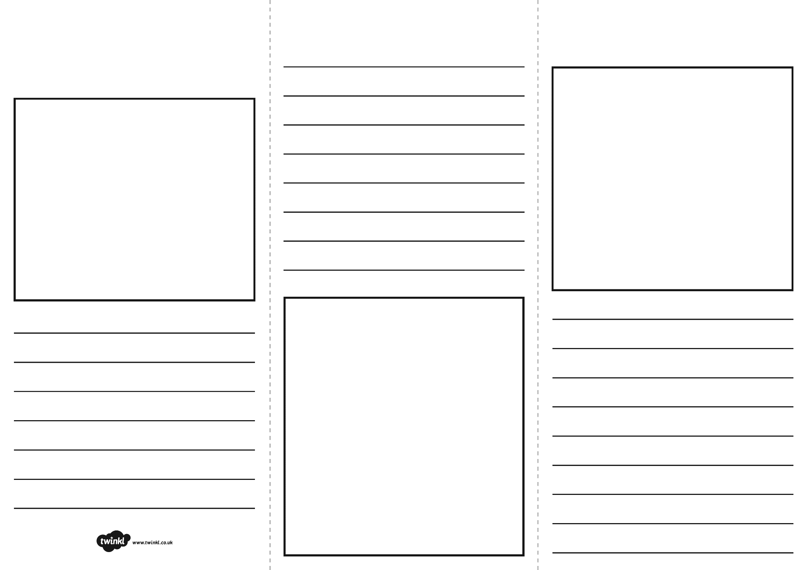
The Impact of Diet and
Exercise: Activity

Slide 13
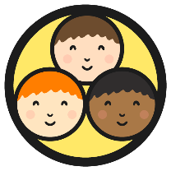

Compare
In your groups, compare the brochures, posters and information texts you have created.
Discuss what makes each of these a good method for sharing information about a healthy lifestyle.

Slide 14

Aim
I can describe how diet and exercise impact on human bodies.
Success Criteria
I can identify what a healthy lifestyle consists of.
I can describe the impact of diet and exercise on the human body.

