Slide 2



Diving into Mastery Guidance for Educators
Each activity sheet is split into three sections, diving, deeper and deepest, which are represented by the following icons:
These carefully designed activities take your children through a learning journey, initially ensuring they are fluent with the key concept being taught; then applying this to a range of reasoning and problem-solving activities.
These sheets might not necessarily be used in a linear way. Some children might begin at the ‘Deeper’ section and in fact, others may ‘dive straight in’ to the ‘Deepest’ section if they have already mastered the skill and are applying this to show their depth of understanding.
Diving
Deeper
Deepest

Slide 3
Aim
Interpret and construct pie charts and line graphs and use these to solve problems.

Slide 4

Draw Line Graphs
Diving
A cyclist is travelling from his home in England to Scotland. The data shows how far from home he was at the end of each day. Yasmin is drawing a line graph of the data.
She has started the graph and has labelled the x-axis
What intervals should Yasmin use on the
y-axis – multiples of 10, multiples of 50
or multiples of 100?
What intervals should Yasmin use on the
y-axis – multiples of 10, multiples of 50
or multiples of 100?
100
90
80
70
60
50
40
30
20
10
0
Monday | 50km
Tuesday | 90km
Wednesday | 210km
Thursday | 295km
Friday | 330km
Saturday | 410km
Sunday | 480km
Multiples of 10 would not be large enough.
M
T
W
T
F
S
S
Days

Slide 5
Draw Line Graphs
Diving
A cyclist is travelling from his home in England to Scotland. The data shows how far from home he was at the end of each day. Yasmin is drawing a line graph of the data.
She has started the graph and has labelled the x-axis
What intervals should Yasmin use on the
y-axis – multiples of 10, multiples of 50
or multiples of 100?
What intervals should Yasmin use on the
y-axis – multiples of 10, multiples of 50
or multiples of 100?
Monday | 50km
Tuesday | 90km
Wednesday | 210km
Thursday | 295km
Friday | 330km
Saturday | 410km
Sunday | 480km
500
450
400
350
300
250
200
150
100
50
0
Multiples of 50 would be large enough to fit the greatest distance on.
M
T
W
T
F
S
S
Days

Slide 6
Draw Line Graphs
Diving
A cyclist is travelling from his home in England to Scotland. The data shows how far from home he was at the end of each day. Yasmin is drawing a line graph of the data.
She has started the graph and has labelled the x-axis
What intervals should Yasmin use on the
y-axis – multiples of 10, multiples of 50
or multiples of 100?
What intervals should Yasmin use on the
y-axis – multiples of 10, multiples of 50
or multiples of 100?
Monday | 50km
Tuesday | 90km
Wednesday | 210km
Thursday | 295km
Friday | 330km
Saturday | 410km
Sunday | 480km
1000
900
800
700
600
500
400
300
200
100
0
Multiples of 100 would be large enough to fit the greatest distance but there would be a lot of the graph paper not used.
M
T
W
T
F
S
S
Days

Slide 7
Draw Line Graphs
Diving
A cyclist is travelling from his home in England to Scotland. The data shows how far from home he was at the end of each day. Yasmin is drawing a line graph of the data.
She has started the graph and has labelled the x-axis
What intervals should Yasmin use on the
y-axis – multiples of 10, multiples of 50
or multiples of 100?
What intervals should Yasmin use on the
y-axis – multiples of 10, multiples of 50
or multiples of 100?
500
450
400
350
300
250
200
150
100
50
0
Monday | 50km
Tuesday | 90km
Wednesday | 210km
Thursday | 295km
Friday | 330km
Saturday | 410km
Sunday | 480km
Multiples of 50 would be best.
M
T
W
T
F
S
S
Days

Slide 8

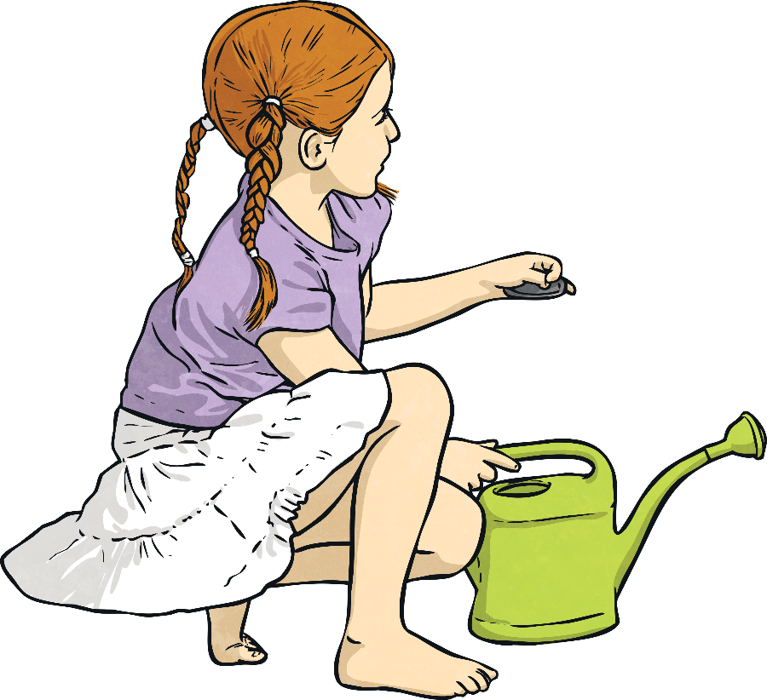
Draw Line Graphs
Deeper
Two children are growing plants. This is how they grew over the first 3 weeks:
 | Start | Week 1 | Week 2 | Week 3
Suzie | 10cm | 18cm | 29cm | 35cm
Sam | 15cm | 24cm | 32cm | 46cm
The data in the table is going to be recorded as a line graph on this piece of paper.

Slide 9
Draw Line Graphs
Deeper
Two children are growing plants. This is how they grew over the first 3 weeks:
 | Start | Week 1 | Week 2 | Week 3
Suzie | 10cm | 18cm | 29cm | 35cm
Sam | 15cm | 24cm | 32cm | 46cm
The data in the table is going to be recorded as a line graph on this piece of paper.
What intervals should Yasmin use on the
y-axis – multiples of 10, multiples of 50
or multiples of 100?
Here are some things different children said about how to draw the graph using cm² paper. Which ones do you agree with? If you do not agree, explain why.
Dan
The x-axis should show the height.
On a line graph, the
x-axis normally shows the passage of time.
Mo
The y-axis should have increments which are multiples of 5.
Ben
The x-axis should show the time.
Kyle
The y-axis should have increments which are multiples of 2.

Slide 10
Draw Line Graphs
Deeper
Two children are growing plants. This is how they grew over the first 3 weeks:
 | Start | Week 1 | Week 2 | Week 3
Suzie | 10cm | 18cm | 29cm | 35cm
Sam | 15cm | 24cm | 32cm | 46cm
The data in the table is going to be recorded as a line graph on this piece of paper.
What intervals should Yasmin use on the
y-axis – multiples of 10, multiples of 50
or multiples of 100?
Here are some things different children said about how to draw the graph using cm² paper. Which ones do you agree with? If you do not agree, explain why.
Dan
The x-axis should show the height.
Mo
The y-axis should have increments which are multiples of 5.
✓
Ben
The x-axis should show the time.
Kyle
The y-axis should have increments which are multiples of 2.

Slide 11
Draw Line Graphs
Deeper
Two children are growing plants. This is how they grew over the first 3 weeks:
 | Start | Week 1 | Week 2 | Week 3
Suzie | 10cm | 18cm | 29cm | 35cm
Sam | 15cm | 24cm | 32cm | 46cm
The data in the table is going to be recorded as a line graph on this piece of paper.
What intervals should Yasmin use on the
y-axis – multiples of 10, multiples of 50
or multiples of 100?
Here are some things different children said about how to draw the graph using cm² paper. Which ones do you agree with? If you do not agree, explain why.
Dan
The x-axis should show the height.
Mo
The y-axis should have increments which are multiples of 5.
Ben
The x-axis should show the time.
✓
Kyle
The y-axis should have increments which are multiples of 2.

Slide 12
Draw Line Graphs
Deeper
Two children are growing plants. This is how they grew over the first 3 weeks:
 | Start | Week 1 | Week 2 | Week 3
Suzie | 10cm | 18cm | 29cm | 35cm
Sam | 15cm | 24cm | 32cm | 46cm
The data in the table is going to be recorded as a line graph on this piece of paper.
What intervals should Yasmin use on the
y-axis – multiples of 10, multiples of 50
or multiples of 100?
Here are some things different children said about how to draw the graph using cm² paper. Which ones do you agree with? If you do not agree, explain why.
Dan
The x-axis should show the height.
If the y-axis was divided into multiples of 2, the paper would not be big enough for the greatest height (46cm).
Mo
The y-axis should have increments which are multiples of 5.
Ben
The x-axis should show the time.
Kyle
The y-axis should have increments which are multiples of 2.

Slide 13

Draw Line Graphs
Deepest
A driver set off on his daily journey at 06:00. This table shows how far he travelled throughout the day:
Patricia draws a line graph. The increments along the x-axis are divided into multiples of 2 hours. (06:00, 08:00, 10:00, etc.)
Lottie also draws a line graph but the increments along the x-axis are divided into multiples of 1 hours. (06:00, 07:00, 08:00, etc.)
Whose graph do you think is most accurate and why?
Time | Distance
07:00 | 17 miles
08:00 | 35 miles
09:00 | 67 miles
10:00 | 67 miles
11:00 | 82 miles
12:00 | 99 miles
13:00 | 130 miles
14:00 | 142 miles
Lottie’s graph will be the most accurate as the table shows the distance every hour. Her graph will closely match the data. Patricia’s graph will only show every other hour. Between 09:00 and 10:00, no distance was covered and this would not be shown on Patricia’s graph.

Slide 14


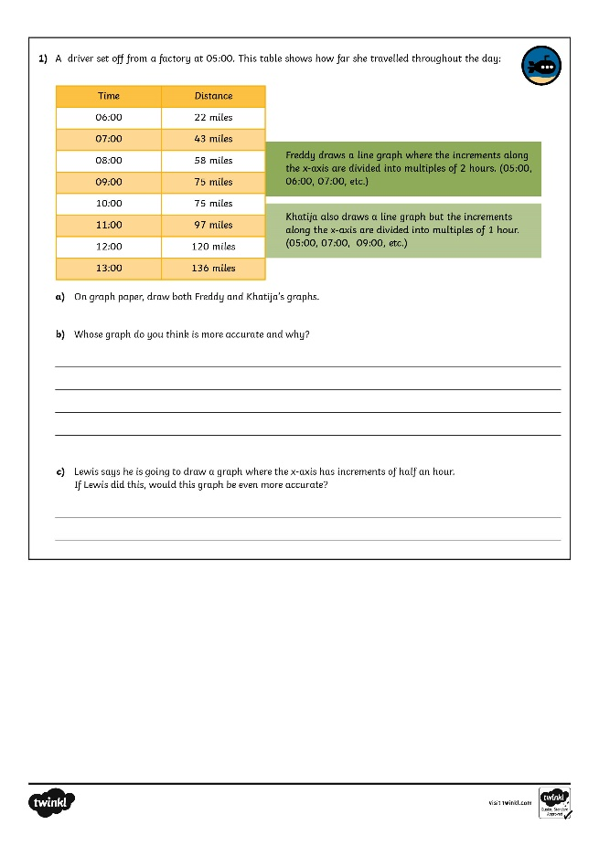
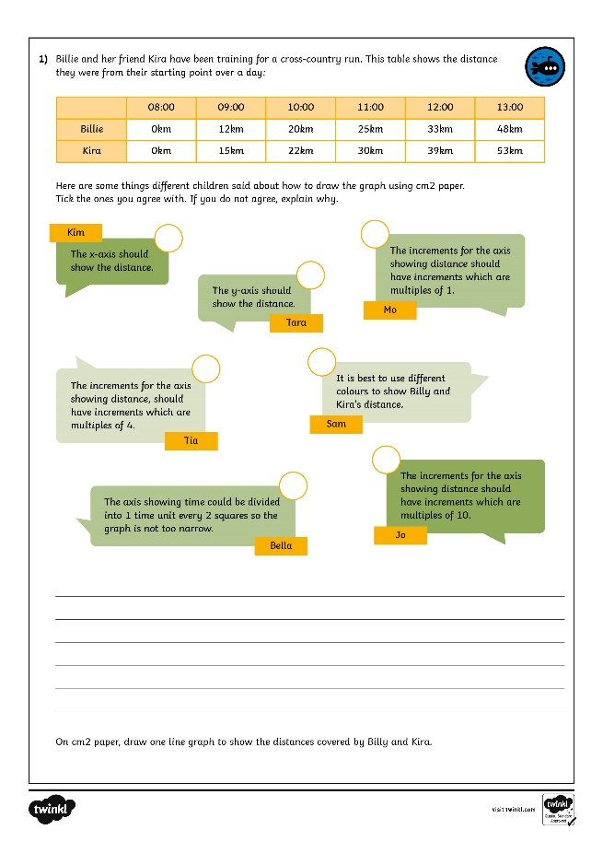
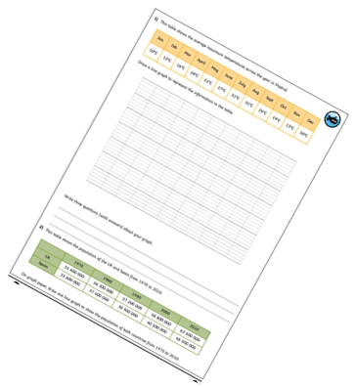
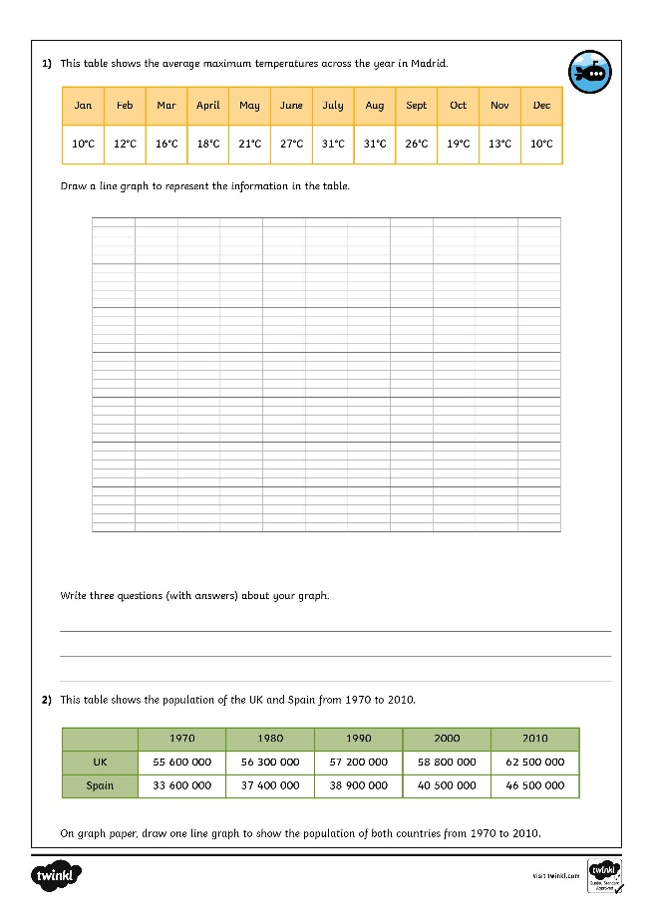
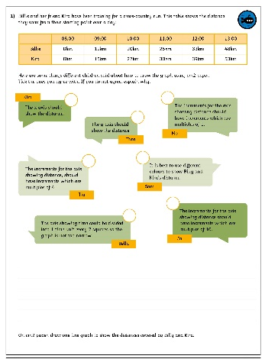
Draw Line Graphs
Dive in by completing your own activity!

Slide 15
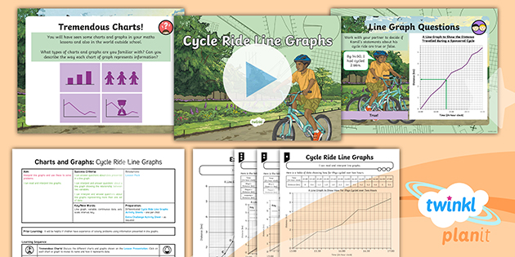
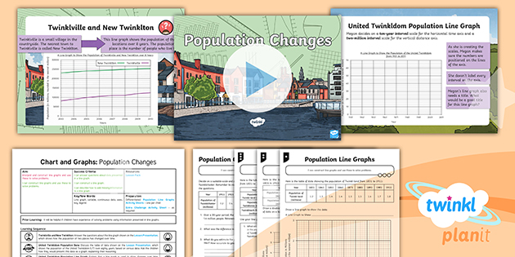

Need Planning to Complement this Resource?
National Curriculum Aim
Interpret and construct pie charts and line graphs and
use these to solve problems.
For more planning resources to support this aim, click here.
Twinkl PlanIt is our award-winning scheme of work
with over 4000 resources.

