Slide 1

India
Location
Facts
Cities
Rural life
Housing
Weather
Chembakolli
Chembakolli continued
/ Tamil Nadu
More info
Notes:
1. Find an image of the country’s flag and place it above the title.

Slide 2
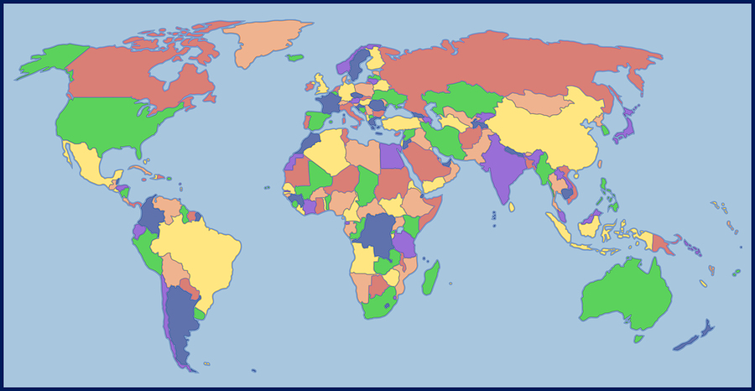
Where is India?
Notes:
1. Move and resize the black ring to circle where India is on the map.

Slide 3
India Facts
Capital city:
Population:
Currency:
Main 2 Languages:
Main Religions:
Main Exports:
Famous landmarks:
Tallest mountains:
Longest river:
Surrounding countries:
Surrounding seas/oceans:
Wildlife:
Notes:
Use Google to find the answers to the questions above. You may need to resize the font, the textbox or the line spacing to make it all fit!
You do not need to add citations to this page as it is commonly know fact.

Slide 4
Images from cities in India
Notes:
Find at least 8 images to show what cities in India look like. Try to find a variety of images. Put your citations below:
Image 1:
Image 2:
Image 3:
Image 4:
Image 5:
Image 6:
Image 7:
Image 8:

Slide 5
Images from rural India
Notes:
1. Find at least 8 images to show what rural life in India looks like. Put your citations below:
Image 1:
Image 2:
Image 3:
Image 4:
Image 5:
Image 6:
Image 7:
Image 8:

Slide 6
Housing in India
Observations:
Notes:
1. Find images of 3 different types of housing in India. Add citations below.
2. Make at least three observations about the housing in India. Why do you think the houses are built the way they are? What features do you notice?
Put your citations below:
Image 1:
Image 2:
Image 3:

Slide 7
Weather in India
Maximum temperatures ºC
Maximum rainfall (cm)
UK
UK
India
India
____ ºC
____ ºC
____ mm
____ mm
What different types of climate does India experience?
___________________________ and
________________________ climates
What types of extreme weather are experienced in India?
Notes:
Search ‘Average temperature in UK’ on Google to and explore the graphs to find the maximum temperature for the UK and India.
Find out the maximum rainfall in both the UK and India. What do you notice?
Find out what type of climate India experiences.
Find out types of extreme weather India experiences.

Slide 8
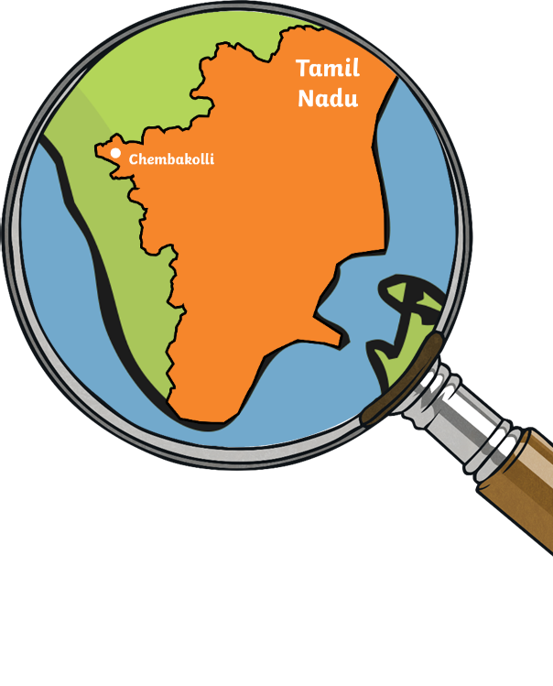
Chembakolli - India
Main Religions
Main Exports
Key buildings/ locations
Notes:
Find 4 images that sum up Chembakolli in Tamil Nadu, India (You may wish to ask for the Chembakolli book as well as online research). Add citations below.
Use the Wikipedia page for Chembakolli (https://en.wikipedia.org/wiki/Chembakolli) as well as the resource book to complete the table of information.
Put your citations below:
Image 1:
Image 2:
Image 3:
Image 4:

Slide 9
Tamil Nadu /Chembakolli
Interesting Facts:
Notes:
Time to choose – do you want this page to be about Tamil Nadu or Chembakolli? Change the title to fit.
Use the internet as well as the resource book to find 5 interesting facts to add to this page.
Or research Tamil Nadu and find out at least 5 interesting facts to add to this page.

Slide 10
More information
Notes:
Use this page to add any of your own research about India. Don’t forget to include citations below for images.

