Slide 1

The Book Legacy
Leave your mark. Inspire future readers.
A new fundraising initiative for our school
Help us fill our library and classrooms with exciting new books
Create a lasting legacy for future pupils

Slide 2
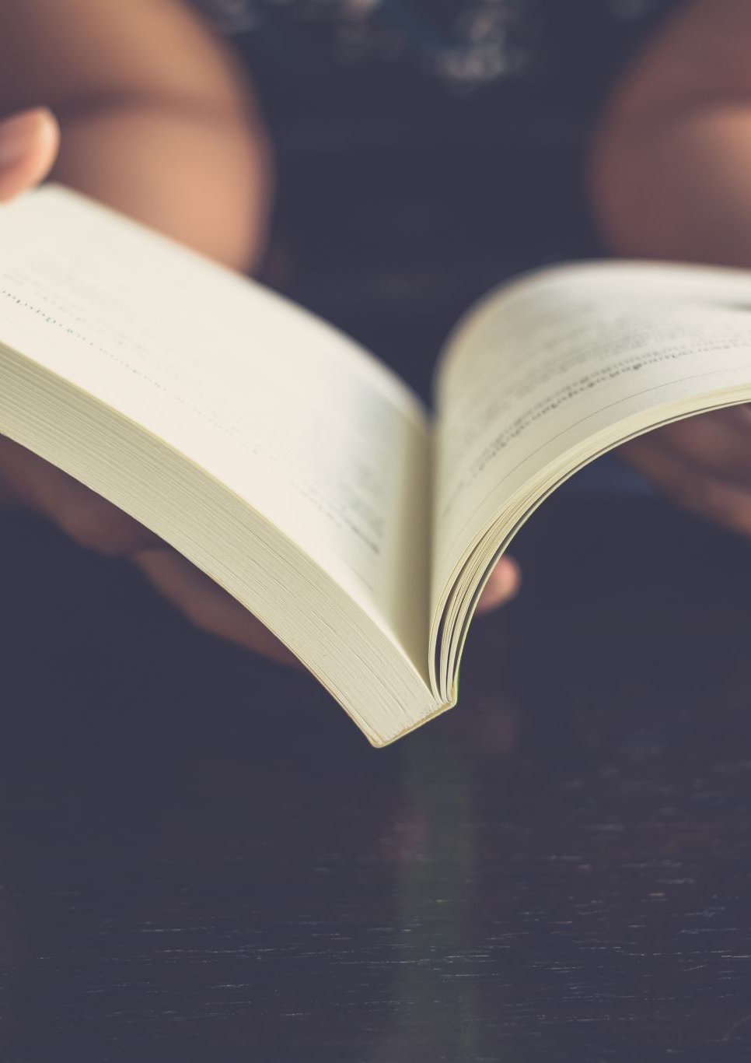
Books Change Lives
Books help us:
Explore new worlds
Learn new things
Grow our imagination
Develop confidence and knowledge
Every child deserves access to brilliant books.

Slide 3
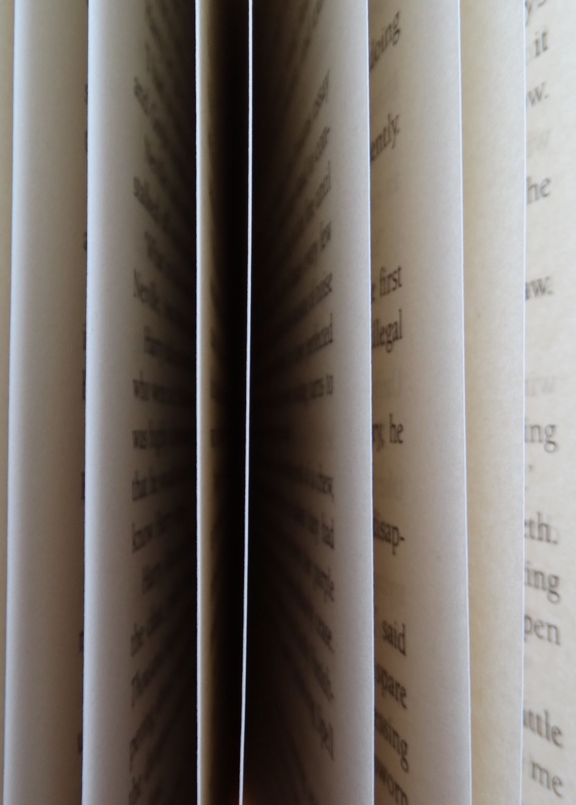
Our Goal
Help Us Raise £2,000
Our target will allow us to purchase:
New fiction books
Fascinating non-fiction
Inspiring poetry
Beautiful picture books
Current Total: £100 raised!

Slide 4

Become Part of Our Story
Sponsor a Book for £5
When a family sponsors a book:
A brand-new book is added to our collection
A personalised bookplate is placed inside
Their name becomes part of our library forever

Slide 5

What Will It Look Like?
Your Legacy in a Book
Example bookplate:
"This book forms part of The Book Legacy and was generously sponsored by the Smith Family."
or
"Part of The Book Legacy – sponsored by Aisha in Year 4.“
You will be invited to design the bookplate template.

Slide 6

A Lasting Legacy
Imagine This...
Years from now:
New pupils will read your sponsored book
Your family's name will still be inside
Your gift will continue helping children enjoy reading
One book. Hundreds of readers. Lasting impact.

Slide 7
Businesses Can Help Too
Community Support
Do you know a local business that could help?
Businesses can:
Sponsor books
Support our fundraising efforts
Receive recognition through a personalised bookplate
Together we can build something special.

Slide 8

How You Can Help
Get Involved Today
✅ Sponsor a book for £5
✅ Tell your family and friends
✅ Encourage local businesses to support us
✅ Help us reach our £2,000 goal

Slide 9

Every Book Makes a Difference
Thank You
"A reader today, a leader tomorrow."
Together, we can create a library that inspires generations of children to come.
The Book Legacy
Leave your mark. Inspire future readers.

Slide 10
The Book Legacy.
Leave your mark.
Inspire future readers.

